Slide 1
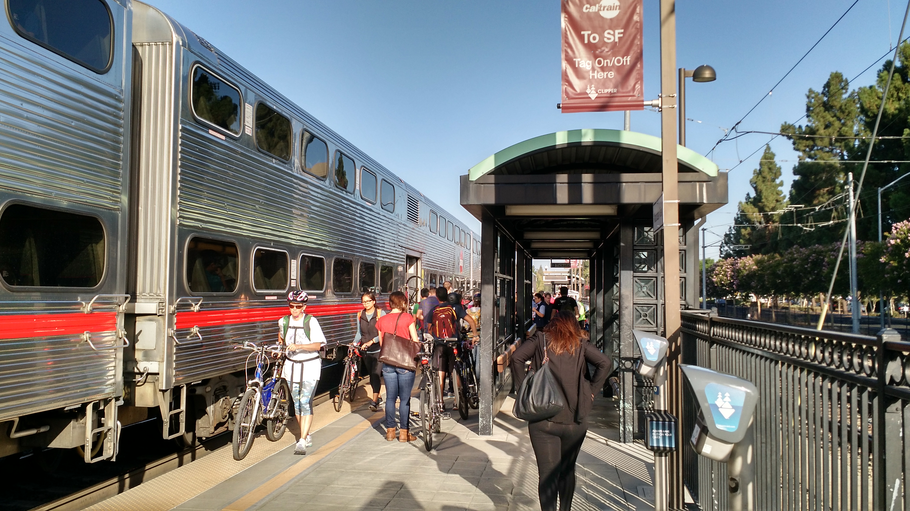
Connecting Palo Alto: Rail Program Master List of Ideas – Initial Screening
City Council
May 14, 2018

Slide 2
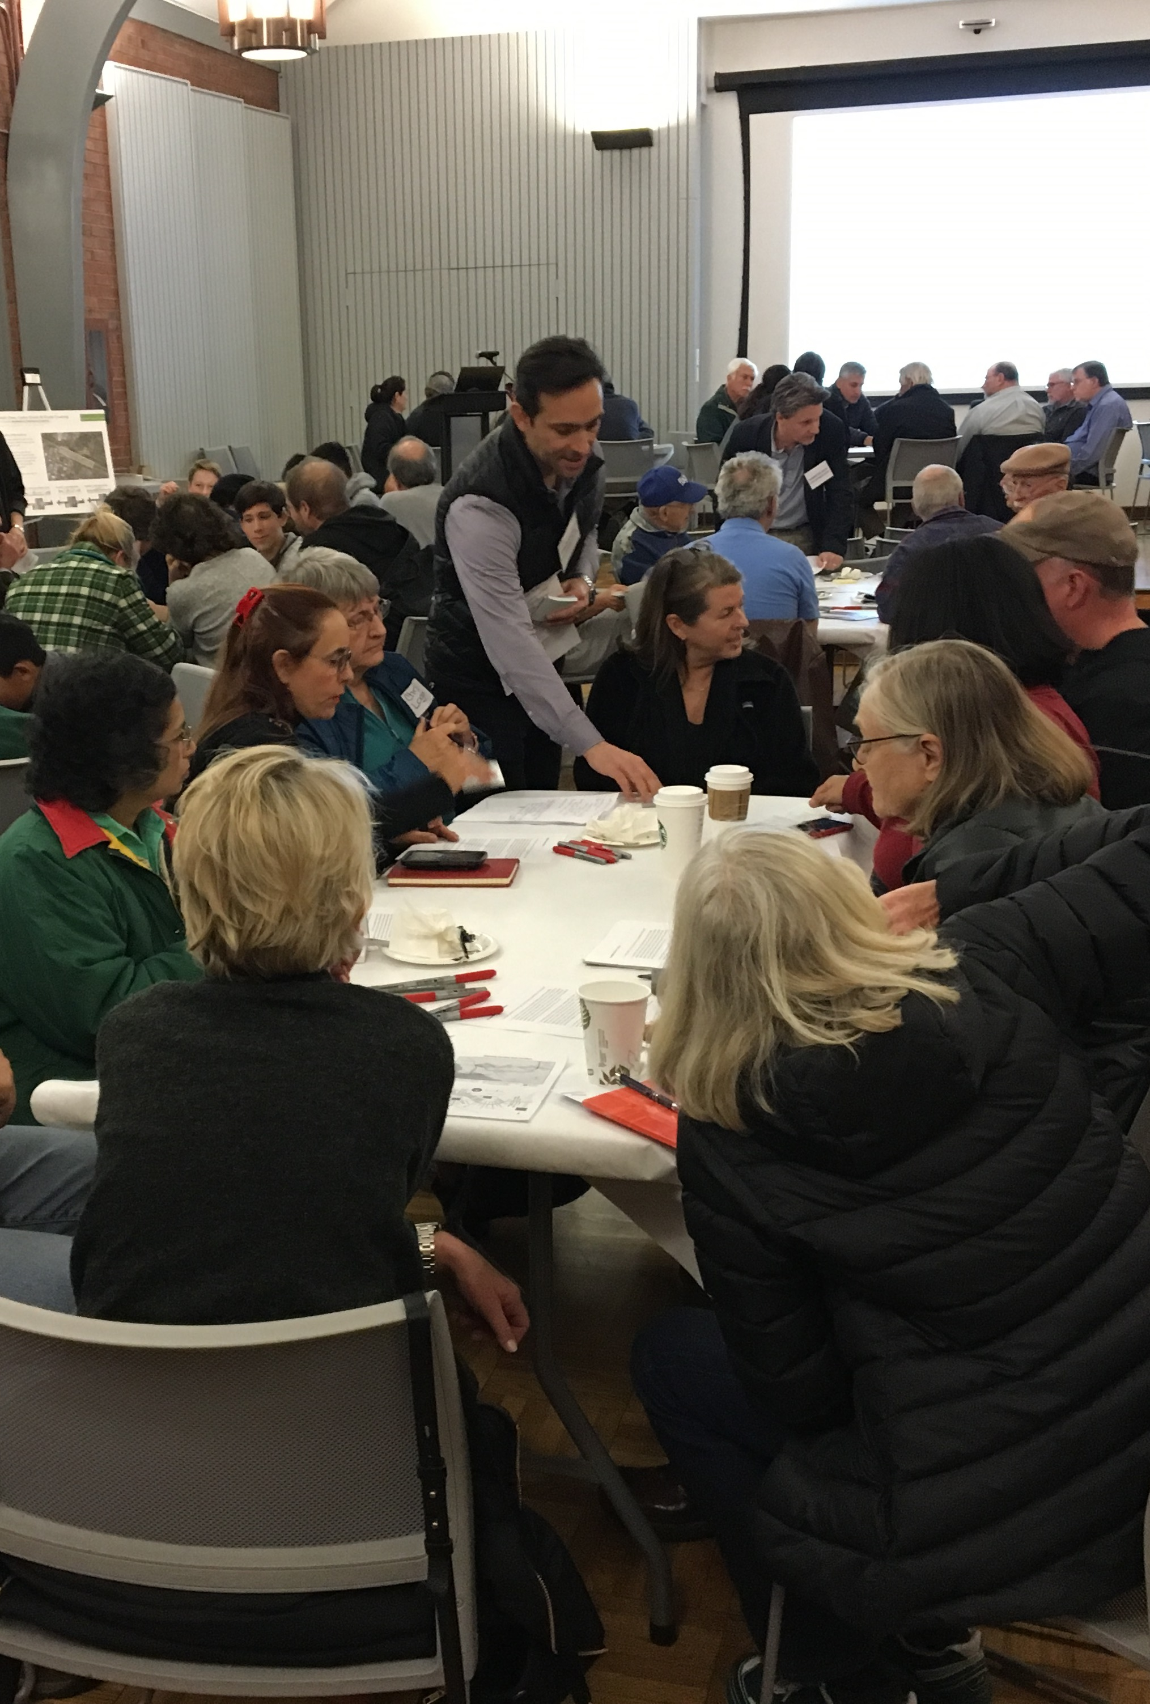
Connecting Palo Alto – 2017 and early 2018
Connecting Palo Alto website www.cityofpaloalto.org/connectingpaloalto
On-line questionnaire with 800 responses
Held 2 Community Workshops, with 228 attendees
Held 4 Community Roundtables, with 381 attendees
Held 14 Rail Committee meetings
Collected 83 public comments / inquiries
Built a database of interested stakeholders
Produced Connecting Palo Alto e-newsletter
Posted extensively on social media

Slide 3
Connecting Palo Alto – Moving Forward
2018 | 1 April | Award new consultant agreement
 | 30 June | Select alternatives to analyze
 | 13 December | Select preferred alternative
2019 | 30 June | Circulate draft EIR
 | 31 December | Certify EIR and select preferred alternative
2020 | 31 January | Approve agency agreements for managing construction
 | 1 February | Begin preliminary design
 | 1 December | Begin final design
2021 | 1 November | Acquire properties? (only if necessary)
2022 | 1 November | Obtain agency permits and / or approvals
2023 | 31 January | Award construction project (s)
 | 1 March | Start construction
2028 | 31 December | Finish construction

Slide 4
Connecting Palo Alto – Mission for 2018
34 Ideas
Initial Screening of 34 Ideas
(Began in March)
4 - 8 Alternatives for Study (June)
1 Preferred Solution (December)
WE ARE HERE

Slide 5
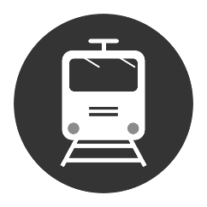
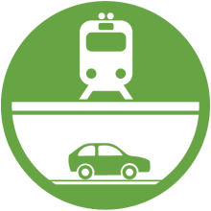
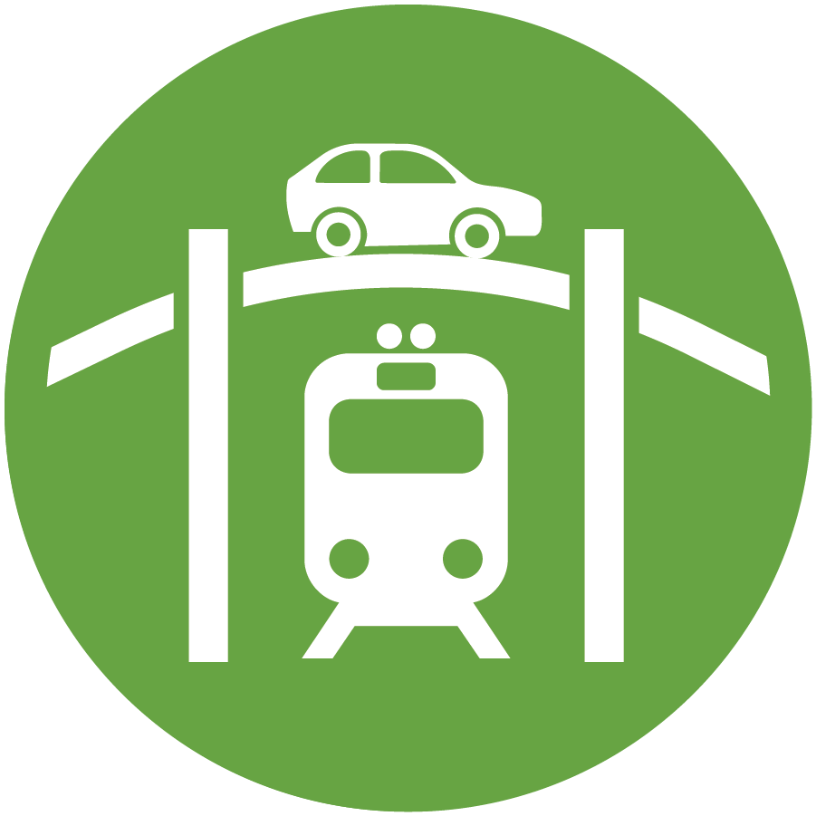
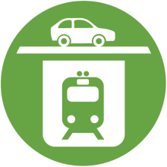
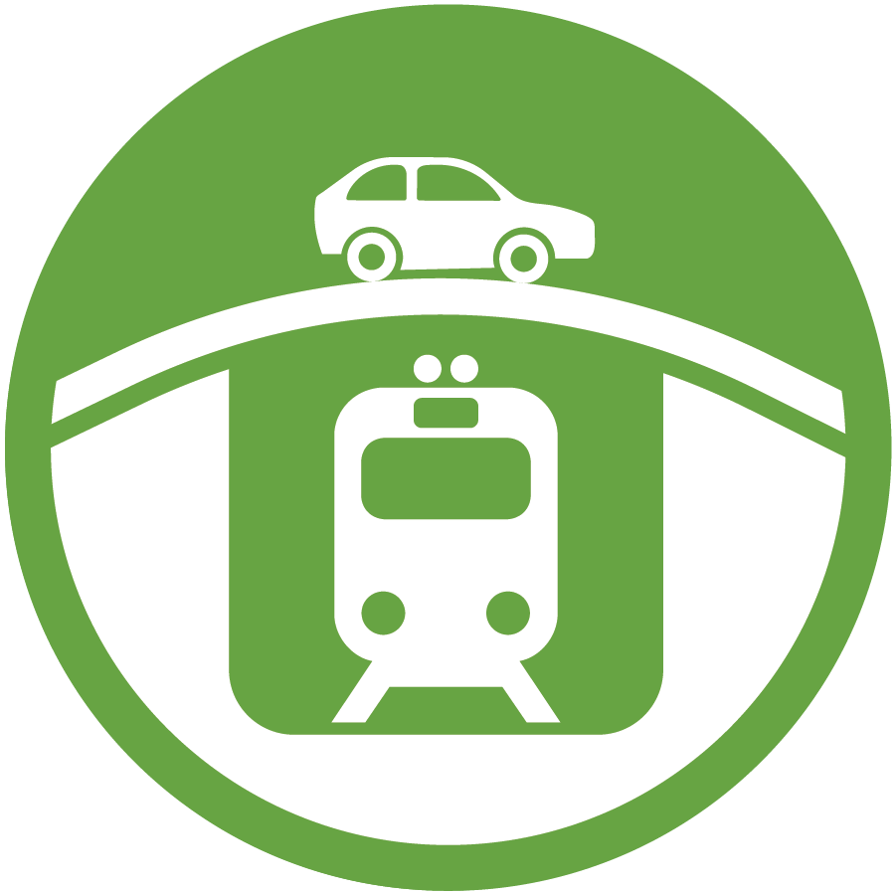
Potential Changes to Existing Crossings
INTERSECTIONS
Charleston Meadow
Churchill Palo Alto
No Build / Do Nothing
Closure
Road Under Rail
Road Over Rail
Hybrids
Rail Under Road
Rail Over Road
Closed to Vehicles Only; Pedestrians & Bicycles OK
Closed to All Traffic
Independent of Alma
Connects to Alma
Alma Below Grade
Alma at Grade

Slide 6
Master List of 34 Ideas from Community Meetings
Type of Separation (Alphabetical Order) | Citywide | Palo Alto | Churchill | Meadow | Charleston
Closure |  | Palo Alto Ave Closed - Everett Bike/Ped (PCE) - Widen University (PCU) - connect Alma Streets in Menlo Park (PCA) - extend Quarry Road to Alma (PCQ) | Churchill Ave Closed - Widen Embarcadero (CAE) - Seale Bike/Ped (CAS) - Kellogg Avenue Bike/Ped (CAK) | Meadow Dr Closed, Loma Verde Bike/Ped (MDL)
Hybrid (Road under Rail) |  | Palo Alto Ave Hybrid (PAH) | Churchill Ave Hybrid (CAH) | Meadow + Charleston Hybrid , Meadow + Charleston Loma Verde Bike/Ped (MCL) Hybrid (MCH)
 |  |  |  | Meadow Dr Hybrid (MDH) | Charleston Road Hybrid (CRH)
No Build / Do Nothing |  | Palo Alto Ave No Build, Safety Upgrades (PAN) | Churchill Ave No Build, Safety Upgrades (CAN) | Meadow Dr No Build - Safety Upgrades (MDN) - No connection to Alma (MDA)
Rail under Road (Trench) | Citywide Trench (WTR) |  | Churchill Ave Trench (CAT) | Meadow + Charleston Trench (MCT) Meadow + Charleston Trench, Alma in Trench (MCA) Meadow Dr Closed, Charleston Trench (MCX)
Rail under Road (Tunnel) | Citywide Deep Bore Tunnel - under El Camino Real (WBE) - under Rail Corridor (WBR) Citywide Cut & Cover Tunnel - under El Camino Real (WCE) - under Rail Corridor (WCR)
Rail over Road (Berm/Viaduct) | Citywide Railroad Berm (WER) Citywide Viaduct (WVR)
Road Over Rail |  |  |  |  | Charleston Rd Roadway Over Railroad (CRO)
Road under Rail |  | Connect Alma to Sand Hill Rd; dead-end Palo Alto Ave (PAT) |  | Meadow Dr Roadway Under Railroad (MDU) | Charleston Rd Road Under Rail - no connection to Alma (CRA) - connected to Alma (CRU)

Slide 7
Refining Process for Decisions
Tier 1 Criteria: Most Important
East-West connectivity: facilitate movement across the corridor for all modes of transportation
Traffic congestion: reduce delay and congestion for automobile traffic at rail crossings
Ped/Bike circulation: provide clear and safe routes for pedestrians and bicyclists seeking to cross the rail corridor, separate from automobile traffic
Rail operations: support continued rail operations and Caltrain service improvements
Cost: finance with feasible funding sources
Tier 2 Criteria: Also Important
Environmental impacts: reduce rail noise and vibration along the corridor
Environmental impacts: minimize visual changes along the rail corridor
Local access: maintain or improve access to neighborhoods, parks, schools and other destinations along the corridor while reducing regional traffic on neighborhood streets
Cost: minimize right-of-way acquisition by eminent domain
Construction: minimize disruption and the duration of construction
Technical
Financial
Adopted by City Council September 6, 2017
Property
Construction
Notes:
Council has adopted framework for evaluating alternatives, with specific criteria
Rather than review them individually, note major categories
Technical – functionality, intentional as well as unintended
Financial – cost can determine feasible or not, as well as options to fund
Property – again one line, but can determine feasibility given community impact of property acquisitions
Construction – fully understanding the impact of construction, including relocating Caltrain, noise, disruption, loss of trees and access

Slide 8
Evaluation Criteria with Sample Ideas
ID | Description of Alternative | Initial Screening Criteria |  |  |  |  |  |  |  |  |  |  |  | Advance into Study
 |  | Tier 1 |  |  |  |  | Tier 2 |  |  |  | New
 |  | Facilitate Movement - All Modes | Reduce Delay and Congestion | Ped-Bike Circulation | Support Rail Operations | Funding Feasibility | Reduce Noise | Minimize Visual Changes | Minimize Right-of-way | Minimize Construction Impacts | Estimated Community Support | Constructability | TAC Opinion
Alternatives
A | Grade Separation Idea A |  |  |  |  | X |  |  |  |  |  | X | ? | N
B | Grade Separation Idea B |  |  |  |  | ✔ |  |  |  |  |  | ✔ | ? | Y
C | Grade Separation Idea C |  |  |  |  | ✔ |  |  |  |  |  | X | ? | N
D | Grade Separation Idea D |  |  |  |  | X |  |  |  |  |  | X | ? | Y
E | Grade Separation Idea E |  |  |  |  | ✔ |  |  |  |  |  | X | ? | Y
Standard Scoring:
= Highest weight
= Middle weight
= Lowest weight
Fatal Flaw Scoring:
✔ = Feasible
X = Possibly Feasible
X = Not Feasible

Slide 9
Initial Screening Process
34 Ideas
18 Ideas identified for potential early elimination due to:
Funding Feasibility Fatal Flaw
Constructability Fatal Flaw
16 Ideas
Presented to Rail Committee (3/21)
and TAC
4 Ideas identified for elimination
6 Ideas combined into 3
1 Idea added per TAC feedback
10 Ideas
Presented to Rail Committee (4/18)
2 Ideas Modified
3 Ideas Removed
3 Ideas Added
10 Rail Committee Recommended Ideas

Slide 10
Master List of 34 Ideas – Initial Screening
Type of Separation (Alphabetical Order) | Citywide | Palo Alto | Churchill | Meadow | Charleston
Closure |  | Palo Alto Ave Closed - Everett Bike/Ped (PCE) - Widen University (PCU) - connect Alma Streets in Menlo Park (PCA) - extend Quarry Road to Alma (PCQ) | Churchill Ave Closed - Widen Embarcadero (CAE) - Seale Bike/Ped (CAS) - Kellogg Avenue Bike/Ped (CAK) | Meadow Dr Closed, Loma Verde Bike/Ped (MDL)
Hybrid (Road under Rail) |  | Palo Alto Ave Hybrid (PAH) | Churchill Ave Hybrid (CAH) | Meadow + Charleston Hybrid , Meadow + Charleston Loma Verde Bike/Ped (MCL) Hybrid (MCH)
 |  |  |  | Meadow Dr Hybrid (MDH) | Charleston Road Hybrid (CRH)
No Build / Do Nothing |  | Palo Alto Ave No Build, Safety Upgrades (PAN) | Churchill Ave No Build, Safety Upgrades (CAN) | Meadow Dr No Build - Safety Upgrades (MDN) - No connection to Alma (MDA)
Rail under Road (Trench) | Citywide Trench (WTR) |  | Churchill Ave Trench (CAT) | Meadow + Charleston Trench (MCT) Meadow + Charleston Trench, Alma in Trench (MCA) Meadow Dr Closed, Charleston Trench (MCX)
Rail under Road (Tunnel) | Citywide Deep Bore Tunnel - under El Camino Real (WBE) - under Rail Corridor (WBR) Citywide Cut & Cover Tunnel - under El Camino Real (WCE) - under Rail Corridor (WCR)
Rail over Road (Berm/Viaduct) | Citywide Railroad Berm (WER) Citywide Viaduct (WVR)
Road Over Rail |  |  |  |  | Charleston Rd Roadway Over Railroad (CRO)
Road under Rail |  | Connect Alma to Sand Hill Rd; dead-end Palo Alto Ave (PAT) |  | Meadow Dr Roadway Under Railroad (MDU) | Charleston Rd Road Under Rail - no connection to Alma (CRA) - connected to Alma (CRU)

Slide 11
Master List of Ideas – Funding Feasibility Fatal Flaw
Type of Separation (Alphabetical Order) | Citywide | Palo Alto | Churchill | Meadow | Charleston
Closure |  | Palo Alto Ave Closed - Everett Bike/Ped (PCE) - Widen University (PCU) - connect Alma Streets in Menlo Park (PCA) - extend Quarry Road to Alma (PCQ) | Churchill Ave Closed - Widen Embarcadero (CAE) - Seale Bike/Ped (CAS) - Kellogg Avenue Bike/Ped (CAK) | Meadow Dr Closed, Loma Verde Bike/Ped (MDL)
Hybrid (Road under Rail) |  | Palo Alto Ave Hybrid (PAH) | Churchill Ave Hybrid (CAH) | Meadow + Charleston Hybrid , Meadow + Charleston Loma Verde Bike/Ped (MCL) Hybrid (MCH)
 |  |  |  | Meadow Dr Hybrid (MDH) | Charleston Road Hybrid (CRH)
No Build / Do Nothing |  | Palo Alto Ave No Build, Safety Upgrades (PAN) | Churchill Ave No Build, Safety Upgrades (CAN) | Meadow Dr No Build - Safety Upgrades (MDN) - No connection to Alma (MDA)
Rail under Road (Trench) | Citywide Trench (WTR) |  | Churchill Ave Trench (CAT) | Meadow + Charleston Trench (MCT) Meadow + Charleston Trench, Alma in Trench (MCA) Meadow Dr Closed, Charleston Trench (MCX)
Rail under Road (Tunnel) | Citywide Deep Bore Tunnel - under El Camino Real (WBE) - under Rail Corridor (WBR) Citywide Cut & Cover Tunnel - under El Camino Real (WCE) - under Rail Corridor (WCR)
Rail over Road (Berm/Viaduct) | Citywide Railroad Berm (WER) Citywide Viaduct (WVR)
Road Over Rail |  |  |  |  | Charleston Rd Roadway Over Railroad (CRO)
Road under Rail |  | Connect Alma to Sand Hill Rd; dead-end Palo Alto Ave (PAT) |  | Meadow Dr Roadway Under Railroad (MDU) | Charleston Rd Road Under Rail - no connection to Alma (CRA) - connected to Alma (CRU)

Slide 12
Master List of Ideas – Constructability Fatal Flaw
Type of Separation (Alphabetical Order) | Citywide | Palo Alto | Churchill | Meadow | Charleston
Closure |  | Palo Alto Ave Closed - Everett Bike/Ped (PCE) - Widen University (PCU) - connect Alma Streets in Menlo Park (PCA) - extend Quarry Road to Alma (PCQ) | Churchill Ave Closed - Widen Embarcadero (CAE) - Seale Bike/Ped (CAS) - Kellogg Avenue Bike/Ped (CAK) | Meadow Dr Closed, Loma Verde Bike/Ped (MDL)
Hybrid (Road under Rail) |  | Palo Alto Ave Hybrid (PAH) | Churchill Ave Hybrid (CAH) | Meadow + Charleston Hybrid , Meadow + Charleston Loma Verde Bike/Ped (MCL) Hybrid (MCH)
 |  |  |  | Meadow Dr Hybrid (MDH) | Charleston Road Hybrid (CRH)
No Build / Do Nothing |  | Palo Alto Ave No Build, Safety Upgrades (PAN) | Churchill Ave No Build, Safety Upgrades (CAN) | Meadow Dr No Build - Safety Upgrades (MDN) - No connection to Alma (MDA)
Rail under Road (Trench) | Citywide Trench (WTR) |  | Churchill Ave Trench (CAT) | Meadow + Charleston Trench (MCT) Meadow + Charleston Trench, Alma in Trench (MCA) Meadow Dr Closed, Charleston Trench (MCX)
Rail under Road (Tunnel) | Citywide Deep Bore Tunnel - under El Camino Real (WBE) - under Rail Corridor (WBR) Citywide Cut & Cover Tunnel - under El Camino Real (WCE) - under Rail Corridor (WCR)
Rail over Road (Berm/Viaduct) | Citywide Railroad Berm (WER) Citywide Viaduct (WVR)
Road Over Rail |  |  |  |  | Charleston Rd Roadway Over Railroad (CRO)
Road under Rail |  | Connect Alma to Sand Hill Rd; dead-end Palo Alto Ave (PAT) |  | Meadow Dr Roadway Under Railroad (MDU) | Charleston Rd Road Under Rail - no connection to Alma (CRA) - connected to Alma (CRU)

Slide 13
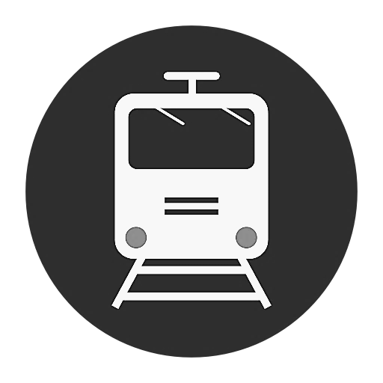
Results of Initial Screening = 16 Ideas
Type of Separation (Alphabetical Order) | Citywide | Palo Alto 2017 ADT (vehicles/day) = 16,200 (+ 550 bikes) | Churchill 2017 ADT (vehicles/day) = 9,200 (+ 1,020 bikes) | Meadow 2017 ADT (vehicles/day) = 8,900 (+ 900 bikes) | Charleston 2017 ADT (vehicles/day) = 17,900 (+ 240 bikes)
Closure |  | Palo Alto Ave Closed, Everett Bike/Ped (PCE) Palo Alto Ave Closed, Widen University (PCU) | Churchill Ave Closed, Widen Embarcadero (CAE) Churchill Ave Closed, Seale Bike/Ped (CAS) | Meadow Dr Closed, Loma Verde Bike/Ped (MDL)
Hybrid (Road under Rail) |  | Palo Alto Ave Hybrid (PAH) | Churchill Ave Hybrid (CAH) | Meadow + Charleston Meadow + Hybrid, Loma Verde Charleston Bike/Ped (MCL) Hybrid (MCH)
 |  |  |  | Meadow Dr Hybrid (MDH) | Charleston Road Hybrid (CRH)
No Build / Do Nothing |  | Palo Alto Ave No Build, Safety Upgrades (PAN) | Churchill Ave No Build, Safety Upgrades (CAN) | Meadow Dr No Build, Safety Upgrades (MDN)
Rail under Road (Trench) |  |  |  | Meadow + Charleston Meadow Dr Closed, Trench (MCT) Charleston Trench (MCX)
Rail under Road (Tunnel)
Rail over Road (Berm/Viaduct)
Road over Rail
Road under Rail
Notes:
Abbreviations
CAE – Close Churchill Ave. crossing, widen existing Embarcadero Rd. undercrossing
CAH – Churchill Ave. crossing with roadway under railroad Hybrid
CAN – Churchill Ave. crossing with No grade separation. Implement minor safety improvements
CAS − Close Churchill Ave. crossing, build bike/ped crossing near planned Seale Ave. bike boulevard to connect to Peers Park and Stanford Ave. bike boulevard
CRH − Charleston Rd. crossing with Hybrid (maintain connection b/w Charleston Rd. and Alma St.)
MCH − Meadow Dr. and Charleston Rd. crossings with roadway under rail Hybrid
MCL − Meadow Dr. and Charleston Rd crossings with roadway under rail Hybrid; new hybrid bike/ped path under rail near Loma Verde Ave.
MCT − Meadow Dr. to Charleston Rd Trench; Alma St. not within trench (maintain connections between Meadow Dr. and Charleston Rd.)
MCX − Close Meadow Dr. crossing; Railroad under roadway trench at Charleston Rd.; Alma St not (X) in trench (maintain connection b/w Meadow Dr. and Charleston Rd.)
MDH − Meadow Dr. crossing with roadway under railroad Hybrid (maintain connection b/w Meadow Dr. & Alma St.)
MDL − Close Meadow Dr. crossing, build bike/ped crossing near Loma Verde Ave. to connect to planned Matadero Ave. bike boulevard
MDN − Meadow Dr. crossing with No grade separation; implement safety improvements
PAH − Continue proposed Menlo Park Hybrid across San Francisquito Creek and Palo Alto Ave. on a viaduct structure
PAN − Palo Alto Ave. crossing with No grade separation; implement safety improvements (quad-gates and wayside horns) with the goal of making a quiet zone
PCE − Palo Alto Ave. crossing Closed; build Everett Ave. bike/ped undercrossing
PCU − Palo Alto Ave. crossing Closed; widen University Ave. roadway undercrossing

Slide 14
Options for Initial Screening - Keep No Builds?
Type of Separation (Alphabetical Order) | Citywide | Palo Alto 2017 ADT (vehicles/day) = 16,200 (+ 550 bikes) | Churchill 2017 ADT (vehicles/day) = 9,200 (+ 1,020 bikes) | Meadow 2017 ADT (vehicles/day) = 8,900 (+ 900 bikes) | Charleston 2017 ADT (vehicles/day) = 17,900 (+ 240 bikes)
Closure |  | Palo Alto Ave Closed, Everett Bike/Ped (PCE) Palo Alto Ave Closed, Widen University (PCU) | Churchill Ave Closed, Widen Embarcadero (CAE) Churchill Ave Closed, Seale Bike/Ped (CAS) | Meadow Dr Closed, Loma Verde Bike/Ped (MDL)
Hybrid (Road under Rail) |  | Palo Alto Ave Hybrid (PAH) | Churchill Ave Hybrid (CAH) | Meadow + Charleston Meadow + Hybrid, Loma Verde Charleston Bike/Ped (MCL) Hybrid (MCH)
 |  |  |  | Meadow Dr Hybrid (MDH) | Charleston Road Hybrid (CRH)
No Build / Do Nothing |  | Palo Alto Ave No Build, Safety Upgrades (PAN) | Churchill Ave No Build, Safety Upgrades (CAN) | Meadow Dr No Build, Safety Upgrades (MDN)
Rail under Road (Trench) |  |  |  | Meadow + Charleston Meadow Dr Closed, Trench (MCT) Charleston Trench (MCX)
Rail under Road (Tunnel)
Rail over Road (Berm/Viaduct)
Road over Rail
Road under Rail
No Build Options may not be realistic or feasible, but CEQA requires them to be considered
Notes:
Abbreviations
CAE – Close Churchill Ave. crossing, widen existing Embarcadero Rd. undercrossing
CAH – Churchill Ave. crossing with roadway under railroad Hybrid
CAN – Churchill Ave. crossing with No grade separation. Implement minor safety improvements
CAS − Close Churchill Ave. crossing, build bike/ped crossing near planned Seale Ave. bike boulevard to connect to Peers Park and Stanford Ave. bike boulevard
CRH − Charleston Rd. crossing with Hybrid (maintain connection b/w Charleston Rd. and Alma St.)
MCH − Meadow Dr. and Charleston Rd. crossings with roadway under rail Hybrid
MCL − Meadow Dr. and Charleston Rd crossings with roadway under rail Hybrid; new hybrid bike/ped path under rail near Loma Verde Ave.
MCT − Meadow Dr. to Charleston Rd Trench; Alma St. not within trench (maintain connections between Meadow Dr. and Charleston Rd.)
MCX − Close Meadow Dr. crossing; Railroad under roadway trench at Charleston Rd.; Alma St not (X) in trench (maintain connection b/w Meadow Dr. and Charleston Rd.)
MDH − Meadow Dr. crossing with roadway under railroad Hybrid (maintain connection b/w Meadow Dr. & Alma St.)
MDL − Close Meadow Dr. crossing, build bike/ped crossing near Loma Verde Ave. to connect to planned Matadero Ave. bike boulevard
MDN − Meadow Dr. crossing with No grade separation; implement safety improvements
PAH − Continue proposed Menlo Park Hybrid across San Francisquito Creek and Palo Alto Ave. on a viaduct structure
PAN − Palo Alto Ave. crossing with No grade separation; implement safety improvements (quad-gates and wayside horns) with the goal of making a quiet zone
PCE − Palo Alto Ave. crossing Closed; build Everett Ave. bike/ped undercrossing
PCU − Palo Alto Ave. crossing Closed; widen University Ave. roadway undercrossing

Slide 15
Options for Initial Screening – Remove Unnecessary
Type of Separation (Alphabetical Order) | Citywide | Palo Alto 2017 ADT (vehicles/day) = 16,200 (+ 550 bikes) | Churchill 2017 ADT (vehicles/day) = 9,200 (+ 1,020 bikes) | Meadow 2017 ADT (vehicles/day) = 8,900 (+ 900 bikes) | Charleston 2017 ADT (vehicles/day) = 17,900 (+ 240 bikes)
Closure |  | Palo Alto Ave Closed, Everett Bike/Ped (PCE) Palo Alto Ave Closed, Widen University (PCU) | Churchill Ave Closed, Widen Embarcadero (CAE) Churchill Ave Closed, Seale Bike/Ped (CAS) | Meadow Dr Closed, Loma Verde Bike/Ped (MDL)
Hybrid (Road under Rail) |  | Palo Alto Ave Hybrid (PAH) | Churchill Ave Hybrid (CAH) | Meadow + Charleston Meadow + Hybrid, Loma Verde Charleston Bike/Ped (MCL) Hybrid (MCH)
 |  |  |  | Meadow Dr Hybrid (MDH) | Charleston Road Hybrid (CRH)
No Build / Do Nothing |  | Palo Alto Ave No Build, Safety Upgrades (PAN) | Churchill Ave No Build, Safety Upgrades (CAN) | Meadow Dr No Build, Safety Upgrades (MDN)
Rail under Road (Trench) |  |  |  | Meadow + Charleston Meadow Dr Closed, Trench (MCT) Charleston Trench (MCX)
Rail under Road (Tunnel)
Rail over Road (Berm/Viaduct)
Road over Rail
Road under Rail
No design benefit compared to MCT. A 2% grade is still required south of Charleston Rd.
Notes:
Abbreviations
CAE – Close Churchill Ave. crossing, widen existing Embarcadero Rd. undercrossing
CAH – Churchill Ave. crossing with roadway under railroad Hybrid
CAN – Churchill Ave. crossing with No grade separation. Implement minor safety improvements
CAS − Close Churchill Ave. crossing, build bike/ped crossing near planned Seale Ave. bike boulevard to connect to Peers Park and Stanford Ave. bike boulevard
CRH − Charleston Rd. crossing with Hybrid (maintain connection b/w Charleston Rd. and Alma St.)
MCH − Meadow Dr. and Charleston Rd. crossings with roadway under rail Hybrid
MCL − Meadow Dr. and Charleston Rd crossings with roadway under rail Hybrid; new hybrid bike/ped path under rail near Loma Verde Ave.
MCT − Meadow Dr. to Charleston Rd Trench; Alma St. not within trench (maintain connections between Meadow Dr. and Charleston Rd.)
MCX − Close Meadow Dr. crossing; Railroad under roadway trench at Charleston Rd.; Alma St not (X) in trench (maintain connection b/w Meadow Dr. and Charleston Rd.)
MDH − Meadow Dr. crossing with roadway under railroad Hybrid (maintain connection b/w Meadow Dr. & Alma St.)
MDL − Close Meadow Dr. crossing, build bike/ped crossing near Loma Verde Ave. to connect to planned Matadero Ave. bike boulevard
MDN − Meadow Dr. crossing with No grade separation; implement safety improvements
PAH − Continue proposed Menlo Park Hybrid across San Francisquito Creek and Palo Alto Ave. on a viaduct structure
PAN − Palo Alto Ave. crossing with No grade separation; implement safety improvements (quad-gates and wayside horns) with the goal of making a quiet zone
PCE − Palo Alto Ave. crossing Closed; build Everett Ave. bike/ped undercrossing
PCU − Palo Alto Ave. crossing Closed; widen University Ave. roadway undercrossing

Slide 16
Options for Initial Screening – Combine Adjacent
Type of Separation (Alphabetical Order) | Citywide | Palo Alto 2017 ADT (vehicles/day) = 16,200 (+ 550 bikes) | Churchill 2017 ADT (vehicles/day) = 9,200 (+ 1,020 bikes) | Meadow 2017 ADT (vehicles/day) = 8,900 (+ 900 bikes) | Charleston 2017 ADT (vehicles/day) = 17,900 (+ 240 bikes)
Closure |  | Palo Alto Ave Closed, Everett Bike/Ped (PCE) Palo Alto Ave Closed, Widen University (PCU) | Churchill Ave Closed, Widen Embarcadero (CAE) Churchill Ave Closed, Seale Bike/Ped (CAS) | Meadow Dr Closed, Loma Verde Bike/Ped (MDL)
Hybrid (Road under Rail) |  | Palo Alto Ave Hybrid (PAH) | Churchill Ave Hybrid (CAH) | Meadow + Charleston Meadow + Hybrid, Loma Verde Charleston Bike/Ped (MCL) Hybrid (MCH)
 |  |  |  | Meadow Dr Hybrid (MDH) | Charleston Road Hybrid (CRH)
No Build / Do Nothing |  | Palo Alto Ave No Build, Safety Upgrades (PAN) | Churchill Ave No Build, Safety Upgrades (CAN) | Meadow Dr No Build, Safety Upgrades (MDN)
Rail under Road (Trench) |  |  |  | Meadow + Charleston Meadow Dr Closed, Trench (MCT) Charleston Trench (MCX)
Rail under Road (Tunnel)
Rail over Road (Berm/Viaduct)
Road over Rail
Road under Rail
No design benefit to closing Meadow without addressing Charleston Rd.
No design benefit when compared to hybrid option that includes both Meadow Dr. and Charleston Rd.
No design benefit when compared to hybrid option that includes both Meadow Dr. and Charleston Rd.
Notes:
Abbreviations
CAE – Close Churchill Ave. crossing, widen existing Embarcadero Rd. undercrossing
CAH – Churchill Ave. crossing with roadway under railroad Hybrid
CAN – Churchill Ave. crossing with No grade separation. Implement minor safety improvements
CAS − Close Churchill Ave. crossing, build bike/ped crossing near planned Seale Ave. bike boulevard to connect to Peers Park and Stanford Ave. bike boulevard
CRH − Charleston Rd. crossing with Hybrid (maintain connection b/w Charleston Rd. and Alma St.)
MCH − Meadow Dr. and Charleston Rd. crossings with roadway under rail Hybrid
MCL − Meadow Dr. and Charleston Rd crossings with roadway under rail Hybrid; new hybrid bike/ped path under rail near Loma Verde Ave.
MCT − Meadow Dr. to Charleston Rd Trench; Alma St. not within trench (maintain connections between Meadow Dr. and Charleston Rd.)
MCX − Close Meadow Dr. crossing; Railroad under roadway trench at Charleston Rd.; Alma St not (X) in trench (maintain connection b/w Meadow Dr. and Charleston Rd.)
MDH − Meadow Dr. crossing with roadway under railroad Hybrid (maintain connection b/w Meadow Dr. & Alma St.)
MDL − Close Meadow Dr. crossing, build bike/ped crossing near Loma Verde Ave. to connect to planned Matadero Ave. bike boulevard
MDN − Meadow Dr. crossing with No grade separation; implement safety improvements
PAH − Continue proposed Menlo Park Hybrid across San Francisquito Creek and Palo Alto Ave. on a viaduct structure
PAN − Palo Alto Ave. crossing with No grade separation; implement safety improvements (quad-gates and wayside horns) with the goal of making a quiet zone
PCE − Palo Alto Ave. crossing Closed; build Everett Ave. bike/ped undercrossing
PCU − Palo Alto Ave. crossing Closed; widen University Ave. roadway undercrossing

Slide 17
Options for Initial Screening – Merge Overlapping
Type of Separation (Alphabetical Order) | Citywide | Palo Alto 2017 ADT (vehicles/day) = 16,200 (+ 550 bikes) | Churchill 2017 ADT (vehicles/day) = 9,200 (+ 1,020 bikes) | Meadow 2017 ADT (vehicles/day) = 8,900 (+ 900 bikes) | Charleston 2017 ADT (vehicles/day) = 17,900 (+ 240 bikes)
Closure |  | Palo Alto Ave Closed, Everett Bike/Ped (PCE) Palo Alto Ave Closed, Widen University (PCU) | Churchill Ave Closed, Widen Embarcadero (CAE) Churchill Ave Closed, Seale Bike/Ped (CAS) | Meadow Dr Closed, Loma Verde Bike/Ped (MDL)
Hybrid (Road under Rail) |  | Palo Alto Ave Hybrid (PAH) | Churchill Ave Hybrid (CAH) | Meadow + Charleston Meadow + Hybrid, Loma Verde Charleston Bike/Ped (MCL) Hybrid (MCH)
 |  |  |  | Meadow Dr Hybrid (MDH) | Charleston Road Hybrid (CRH)
No Build / Do Nothing |  | Palo Alto Ave No Build, Safety Upgrades (PAN) | Churchill Ave No Build, Safety Upgrades (CAN) | Meadow Dr No Build, Safety Upgrades (MDN)
Rail under Road (Trench) |  |  |  | Meadow + Charleston Meadow Dr Closed, Trench (MCT) Charleston Trench (MCX)
Rail under Road (Tunnel)
Rail over Road (Berm/Viaduct)
Road over Rail
Road under Rail
Merge MCH with MCL - No design benefit compared to MCL
Notes:
Abbreviations
CAE – Close Churchill Ave. crossing, widen existing Embarcadero Rd. undercrossing
CAH – Churchill Ave. crossing with roadway under railroad Hybrid
CAN – Churchill Ave. crossing with No grade separation. Implement minor safety improvements
CAS − Close Churchill Ave. crossing, build bike/ped crossing near planned Seale Ave. bike boulevard to connect to Peers Park and Stanford Ave. bike boulevard
CRH − Charleston Rd. crossing with Hybrid (maintain connection b/w Charleston Rd. and Alma St.)
MCH − Meadow Dr. and Charleston Rd. crossings with roadway under rail Hybrid
MCL − Meadow Dr. and Charleston Rd crossings with roadway under rail Hybrid; new hybrid bike/ped path under rail near Loma Verde Ave.
MCT − Meadow Dr. to Charleston Rd Trench; Alma St. not within trench (maintain connections between Meadow Dr. and Charleston Rd.)
MCX − Close Meadow Dr. crossing; Railroad under roadway trench at Charleston Rd.; Alma St not (X) in trench (maintain connection b/w Meadow Dr. and Charleston Rd.)
MDH − Meadow Dr. crossing with roadway under railroad Hybrid (maintain connection b/w Meadow Dr. & Alma St.)
MDL − Close Meadow Dr. crossing, build bike/ped crossing near Loma Verde Ave. to connect to planned Matadero Ave. bike boulevard
MDN − Meadow Dr. crossing with No grade separation; implement safety improvements
PAH − Continue proposed Menlo Park Hybrid across San Francisquito Creek and Palo Alto Ave. on a viaduct structure
PAN − Palo Alto Ave. crossing with No grade separation; implement safety improvements (quad-gates and wayside horns) with the goal of making a quiet zone
PCE − Palo Alto Ave. crossing Closed; build Everett Ave. bike/ped undercrossing
PCU − Palo Alto Ave. crossing Closed; widen University Ave. roadway undercrossing

Slide 18
Options for Initial Screening – Combine Similar
Type of Separation (Alphabetical Order) | Citywide | Palo Alto 2017 ADT (vehicles/day) = 16,200 (+ 550 bikes) | Churchill 2017 ADT (vehicles/day) = 9,200 (+ 1,020 bikes) | Meadow 2017 ADT (vehicles/day) = 8,900 (+ 900 bikes) | Charleston 2017 ADT (vehicles/day) = 17,900 (+ 240 bikes)
Closure |  | Palo Alto Ave Closed, Everett Bike/Ped (PCE) Palo Alto Ave Closed, Widen University (PCU) | Churchill Ave Closed, Widen Embarcadero (CAE) Churchill Ave Closed, Seale Bike/Ped (CAS) | Meadow Dr Closed, Loma Verde Bike/Ped (MDL)
Hybrid (Road under Rail) |  | Palo Alto Ave Hybrid (PAH) | Churchill Ave Hybrid (CAH) | Meadow + Charleston Meadow + Hybrid, Loma Verde Charleston Bike/Ped (MCL) Hybrid (MCH)
 |  |  |  | Meadow Dr Hybrid (MDH) | Charleston Road Hybrid (CRH)
No Build / Do Nothing |  | Palo Alto Ave No Build, Safety Upgrades (PAN) | Churchill Ave No Build, Safety Upgrades (CAN) | Meadow Dr No Build, Safety Upgrades (MDN)
Rail under Road (Trench) |  |  |  | Meadow + Charleston Meadow Dr Closed, Trench (MCT) Charleston Trench (MCX)
Rail under Road (Tunnel)
Rail over Road (Berm/Viaduct)
Road over Rail
Road under Rail
Combine PCE and PCU into PCX, with a list of possible improvement options to choose from
Combine CAE and CAS into CAX, with a list of possible improvement options to choose from
Notes:
Abbreviations
CAE – Close Churchill Ave. crossing, widen existing Embarcadero Rd. undercrossing
CAH – Churchill Ave. crossing with roadway under railroad Hybrid
CAN – Churchill Ave. crossing with No grade separation. Implement minor safety improvements
CAS − Close Churchill Ave. crossing, build bike/ped crossing near planned Seale Ave. bike boulevard to connect to Peers Park and Stanford Ave. bike boulevard
CRH − Charleston Rd. crossing with Hybrid (maintain connection b/w Charleston Rd. and Alma St.)
MCH − Meadow Dr. and Charleston Rd. crossings with roadway under rail Hybrid
MCL − Meadow Dr. and Charleston Rd crossings with roadway under rail Hybrid; new hybrid bike/ped path under rail near Loma Verde Ave.
MCT − Meadow Dr. to Charleston Rd Trench; Alma St. not within trench (maintain connections between Meadow Dr. and Charleston Rd.)
MCX − Close Meadow Dr. crossing; Railroad under roadway trench at Charleston Rd.; Alma St not (X) in trench (maintain connection b/w Meadow Dr. and Charleston Rd.)
MDH − Meadow Dr. crossing with roadway under railroad Hybrid (maintain connection b/w Meadow Dr. & Alma St.)
MDL − Close Meadow Dr. crossing, build bike/ped crossing near Loma Verde Ave. to connect to planned Matadero Ave. bike boulevard
MDN − Meadow Dr. crossing with No grade separation; implement safety improvements
PAH − Continue proposed Menlo Park Hybrid across San Francisquito Creek and Palo Alto Ave. on a viaduct structure
PAN − Palo Alto Ave. crossing with No grade separation; implement safety improvements (quad-gates and wayside horns) with the goal of making a quiet zone
PCE − Palo Alto Ave. crossing Closed; build Everett Ave. bike/ped undercrossing
PCU − Palo Alto Ave. crossing Closed; widen University Ave. roadway undercrossing

Slide 19
Options for Initial Screening – Add TAC Suggestion
Type of Separation (Alphabetical Order) | Citywide | Palo Alto 2017 ADT (vehicles/day) = 16,200 (+ 550 bikes) | Churchill 2017 ADT (vehicles/day) = 9,200 (+ 1,020 bikes) | Meadow 2017 ADT (vehicles/day) = 8,900 (+ 900 bikes) | Charleston 2017 ADT (vehicles/day) = 17,900 (+ 240 bikes)
Closure |  | Palo Alto Ave Closed, Everett Bike/Ped (PCE) Palo Alto Ave Closed, Widen University (PCU) | Churchill Ave Closed, Widen Embarcadero (CAE) Churchill Ave Closed, Seale Bike/Ped (CAS) | Meadow Dr Closed, Loma Verde Bike/Ped (MDL)
Hybrid (Road under Rail) |  | Palo Alto Ave Hybrid (PAH) | Churchill Ave Hybrid (CAH) | Meadow + Charleston Meadow + Hybrid, Loma Verde Charleston Bike/Ped (MCL) Hybrid (MCH)
 |  |  |  | Meadow Dr Hybrid (MDH) | Charleston Road Hybrid (CRH)
No Build / Do Nothing |  | Palo Alto Ave No Build, Safety Upgrades (PAN) | Churchill Ave No Build, Safety Upgrades (CAN) | Meadow Dr No Build, Safety Upgrades (MDN)
Rail under Road (Trench) |  |  |  | Meadow + Charleston Meadow Dr Closed, Trench (MCT) Charleston Trench (MCX)
Rail under Road (Tunnel)
Rail over Road (Berm/Viaduct)
Road over Rail
Road under Rail
PCX
CAX
Caltrain recommends exploring both a Road over Rail Hybrid as well as a Road under Rail Hybrid
Notes:
Abbreviations
CAE – Close Churchill Ave. crossing, widen existing Embarcadero Rd. undercrossing
CAH – Churchill Ave. crossing with roadway under railroad Hybrid
CAN – Churchill Ave. crossing with No grade separation. Implement minor safety improvements
CAS − Close Churchill Ave. crossing, build bike/ped crossing near planned Seale Ave. bike boulevard to connect to Peers Park and Stanford Ave. bike boulevard
CRH − Charleston Rd. crossing with Hybrid (maintain connection b/w Charleston Rd. and Alma St.)
MCH − Meadow Dr. and Charleston Rd. crossings with roadway under rail Hybrid
MCL − Meadow Dr. and Charleston Rd crossings with roadway under rail Hybrid; new hybrid bike/ped path under rail near Loma Verde Ave.
MCT − Meadow Dr. to Charleston Rd Trench; Alma St. not within trench (maintain connections between Meadow Dr. and Charleston Rd.)
MCX − Close Meadow Dr. crossing; Railroad under roadway trench at Charleston Rd.; Alma St not (X) in trench (maintain connection b/w Meadow Dr. and Charleston Rd.)
MDH − Meadow Dr. crossing with roadway under railroad Hybrid (maintain connection b/w Meadow Dr. & Alma St.)
MDL − Close Meadow Dr. crossing, build bike/ped crossing near Loma Verde Ave. to connect to planned Matadero Ave. bike boulevard
MDN − Meadow Dr. crossing with No grade separation; implement safety improvements
PAH − Continue proposed Menlo Park Hybrid across San Francisquito Creek and Palo Alto Ave. on a viaduct structure
PAN − Palo Alto Ave. crossing with No grade separation; implement safety improvements (quad-gates and wayside horns) with the goal of making a quiet zone
PCE − Palo Alto Ave. crossing Closed; build Everett Ave. bike/ped undercrossing
PCU − Palo Alto Ave. crossing Closed; widen University Ave. roadway undercrossing

Slide 20
Selecting All Options = 10 Ideas
Type of Separation (Alphabetical Order) | Citywide | Palo Alto 2017 ADT (vehicles/day) = 16,200 (+ 550 bikes) | Churchill 2017 ADT (vehicles/day) = 9,200 (+ 1,020 bikes) | Meadow 2017 ADT (vehicles/day) = 8,900 (+ 900 bikes) | Charleston 2017 ADT (vehicles/day) = 17,900 (+ 240 bikes)
Closure |  | Palo Alto Ave Closed, Add Improvements (PCX) | Churchill Ave Closed, Add Improvements (CAX)
Hybrid (Road over Rail) |  |  |  | Meadow + Charleston Road Over Rail Hybrid, Loma Verde Bike/Ped (MCR)
Hybrid (Road under Rail) |  | Palo Alto Ave Hybrid (PAH) | Churchill Ave Hybrid (CAH) | Meadow + Charleston Road Under Rail Hybrid, Loma Verde Bike/Ped (MCL)
No Build / Do Nothing |  | Palo Alto Ave No Build, Safety Upgrades (PAN) | Churchill Ave No Build, Safety Upgrades (CAN) | Meadow Dr No Build, Safety Upgrades (MDN)
Rail under Road (Trench) |  |  |  | Meadow + Charleston Trench (MCT)
Rail under Road (Tunnel)
Rail over Road (Berm/Viaduct)
Road Over Rail
Road under Rail
Notes:
Abbreviations
CAX – Churchill Ave. crossing closed (X); Improvement options include: widen existing Embarcadero Rd. undercrossing, add new traffic signals at Embarcadero Rd. ramp, and build bike/ped crossing near planned Seale Ave. bike boulevard to connect to Peers Park and Stanford Ave. bike boulevard
CAH – Churchill Ave. crossing with roadway under railroad Hybrid
MCL − Meadow Dr. and Charleston Rd crossings with roadway under rail Hybrid; new hybrid bike/ped path under rail near Loma Verde Ave.
MCR − Meadow Dr. and Charleston Rd crossings with Roadway over rail Hybrid; new hybrid bike/ped path under rail near Loma Verde Ave.
MCT − Meadow Dr. to Charleston Rd Trench; Alma St. not within trench (maintain connections between Meadow Dr. and Charleston Rd.)
PAH − Continue proposed Menlo Park Hybrid across San Francisquito Creek and Palo Alto Ave. on a viaduct structure
PCX − Palo Alto Ave. Crossing closed (X); Improvement options include: build Everett Ave. bike/ped undercrossing and widen University Ave.

Slide 21
Rail Committee Recommendations – Modify Ideas
Type of Separation (Alphabetical Order) | Citywide | Palo Alto 2017 ADT (vehicles/day) = 16,200 (+ 550 bikes) | Churchill 2017 ADT (vehicles/day) = 9,200 (+ 1,020 bikes) | Meadow 2017 ADT (vehicles/day) = 8,900 (+ 900 bikes) | Charleston 2017 ADT (vehicles/day) = 17,900 (+ 240 bikes)
Closure |  | Palo Alto Ave Closed, Add Improvements (PCX) | Churchill Ave Closed, Add Improvements (CAX)
Hybrid (Road over Rail) |  |  |  | Meadow + Charleston Road Over Rail Hybrid, Loma Verde Bike/Ped (MCR)
Hybrid (Road under Rail) |  | Palo Alto Ave Hybrid (PAH) | Churchill Ave Hybrid (CAH) | Meadow + Charleston Road Under Rail Hybrid, Loma Verde Bike/Ped (MCL)
No Build / Do Nothing |  | Palo Alto Ave No Build, Safety Upgrades (PAN) | Churchill Ave No Build, Safety Upgrades (CAN) | Meadow Dr No Build, Safety Upgrades (MDN)
Rail under Road (Trench) |  |  |  | Meadow + Charleston Trench (MCT)
Rail under Road (Tunnel)
Rail over Road (Berm/Viaduct)
Road Over Rail
Road under Rail
Add "and/or viaduct” to PAH
Add “or tunnel” to MCT
Notes:
Abbreviations
CAX – Churchill Ave. crossing closed (X); Improvement options include: widen existing Embarcadero Rd. undercrossing, add new traffic signals at Embarcadero Rd. ramp, and build bike/ped crossing near planned Seale Ave. bike boulevard to connect to Peers Park and Stanford Ave. bike boulevard
CAH – Churchill Ave. crossing with roadway under railroad Hybrid
MCL − Meadow Dr. and Charleston Rd crossings with roadway under rail Hybrid; new hybrid bike/ped path under rail near Loma Verde Ave.
MCR − Meadow Dr. and Charleston Rd crossings with Roadway over rail Hybrid; new hybrid bike/ped path under rail near Loma Verde Ave.
MCT − Meadow Dr. to Charleston Rd Trench; Alma St. not within trench (maintain connections between Meadow Dr. and Charleston Rd.)
PAH − Continue proposed Menlo Park Hybrid across San Francisquito Creek and Palo Alto Ave. on a viaduct structure
PCX − Palo Alto Ave. Crossing closed (X); Improvement options include: build Everett Ave. bike/ped undercrossing and widen University Ave.

Slide 22
Rail Committee Recommendations – Remove No Build
Type of Separation (Alphabetical Order) | Citywide | Palo Alto 2017 ADT (vehicles/day) = 16,200 (+ 550 bikes) | Churchill 2017 ADT (vehicles/day) = 9,200 (+ 1,020 bikes) | Meadow 2017 ADT (vehicles/day) = 8,900 (+ 900 bikes) | Charleston 2017 ADT (vehicles/day) = 17,900 (+ 240 bikes)
Closure |  | Palo Alto Ave Closed, Add Improvements (PCX) | Churchill Ave Closed, Add Improvements (CAX)
Hybrid (Road over Rail) |  |  |  | Meadow + Charleston Road Over Rail Hybrid, Loma Verde Bike/Ped (MCR)
Hybrid (Road under Rail) |  | Palo Alto Ave Hybrid and/or Viaduct (PAH) | Churchill Ave Hybrid (CAH) | Meadow + Charleston Road Under Rail Hybrid, Loma Verde Bike/Ped (MCL)
No Build / Do Nothing |  | Palo Alto Ave No Build, Safety Upgrades (PAN) | Churchill Ave No Build, Safety Upgrades (CAN) | Meadow Dr No Build, Safety Upgrades (MDN)
Rail under Road (Trench) |  |  |  | Meadow + Charleston Trench or Tunnel (MCT)
Rail under Road (Tunnel)
Rail over Road (Berm/Viaduct)
Road Over Rail
Road under Rail
Notes:
Abbreviations
CAX – Churchill Ave. crossing closed (X); Improvement options include: widen existing Embarcadero Rd. undercrossing, add new traffic signals at Embarcadero Rd. ramp, and build bike/ped crossing near planned Seale Ave. bike boulevard to connect to Peers Park and Stanford Ave. bike boulevard
CAH – Churchill Ave. crossing with roadway under railroad Hybrid
MCL − Meadow Dr. and Charleston Rd crossings with roadway under rail Hybrid; new hybrid bike/ped path under rail near Loma Verde Ave.
MCR − Meadow Dr. and Charleston Rd crossings with Roadway over rail Hybrid; new hybrid bike/ped path under rail near Loma Verde Ave.
MCT − Meadow Dr. to Charleston Rd Trench; Alma St. not within trench (maintain connections between Meadow Dr. and Charleston Rd.)
PAH − Continue proposed Menlo Park Hybrid across San Francisquito Creek and Palo Alto Ave. on a viaduct structure
PCX − Palo Alto Ave. Crossing closed (X); Improvement options include: build Everett Ave. bike/ped undercrossing and widen University Ave.

Slide 23
Rail Committee Recommendations – Add New Ideas
Type of Separation (Alphabetical Order) | Citywide | Palo Alto 2017 ADT (vehicles/day) = 16,200 (+ 550 bikes) | Churchill 2017 ADT (vehicles/day) = 9,200 (+ 1,020 bikes) | Meadow 2017 ADT (vehicles/day) = 8,900 (+ 900 bikes) | Charleston 2017 ADT (vehicles/day) = 17,900 (+ 240 bikes)
Closure |  | Palo Alto Ave Closed, Add Improvements (PCX) | Churchill Ave Closed, Add Improvements (CAX)
Hybrid (Road over Rail) |  |  | Add Reverse Hybrid at Churchill Avenue | Meadow + Charleston Road Over Rail Hybrid, Loma Verde Bike/Ped (MCR)
Hybrid (Road under Rail) |  | Palo Alto Ave Hybrid and/or Viaduct (PAH) | Churchill Ave Hybrid (CAH) | Meadow + Charleston Road Under Rail Hybrid, Loma Verde Bike/Ped (MCL)
No Build / Do Nothing |  | Palo Alto Ave No Build, Safety Upgrades (PAN) | Churchill Ave No Build, Safety Upgrades (CAN) | Meadow Dr No Build, Safety Upgrades (MDN)
Rail under Road (Trench) |  |  |  | Meadow + Charleston Trench or Tunnel (MCT)
Rail under Road (Tunnel)
Rail over Road (Berm/Viaduct)
Road Over Rail
Road under Rail
Add Citywide Tunnel within Palo Alto
Add Viaduct for Meadow Dr & Charleston Rd
Notes:
Abbreviations
CAX – Churchill Ave. crossing closed (X); Improvement options include: widen existing Embarcadero Rd. undercrossing, add new traffic signals at Embarcadero Rd. ramp, and build bike/ped crossing near planned Seale Ave. bike boulevard to connect to Peers Park and Stanford Ave. bike boulevard
CAH – Churchill Ave. crossing with roadway under railroad Hybrid
MCL − Meadow Dr. and Charleston Rd crossings with roadway under rail Hybrid; new hybrid bike/ped path under rail near Loma Verde Ave.
MCR − Meadow Dr. and Charleston Rd crossings with Roadway over rail Hybrid; new hybrid bike/ped path under rail near Loma Verde Ave.
MCT − Meadow Dr. to Charleston Rd Trench; Alma St. not within trench (maintain connections between Meadow Dr. and Charleston Rd.)
PAH − Continue proposed Menlo Park Hybrid across San Francisquito Creek and Palo Alto Ave. on a viaduct structure
PCX − Palo Alto Ave. Crossing closed (X); Improvement options include: build Everett Ave. bike/ped undercrossing and widen University Ave.

Slide 24
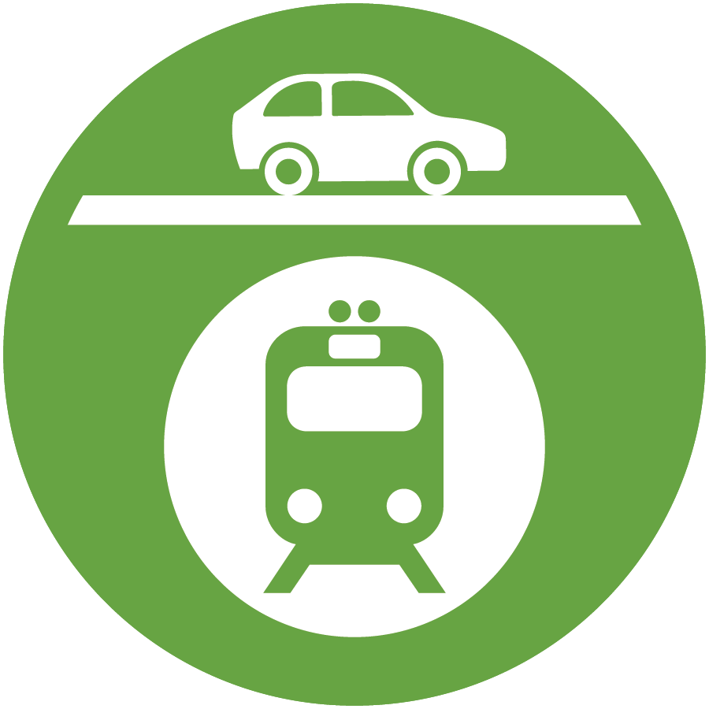
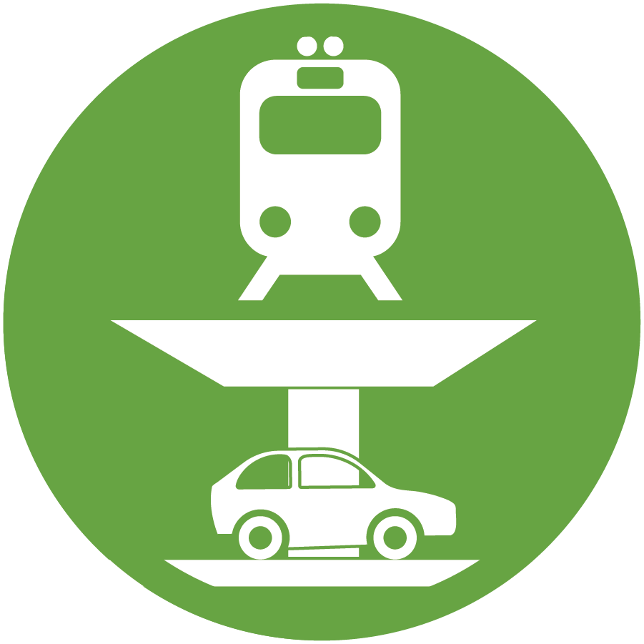
Rail Committee Recommended Ideas
Type of Separation (Alphabetical Order) | Citywide | Palo Alto 2017 ADT (vehicles/day) = 16,200 (+ 550 bikes) | Churchill 2017 ADT (vehicles/day) = 9,200 (+ 1,020 bikes) | Meadow 2017 ADT (vehicles/day) = 8,900 (+ 900 bikes) | Charleston 2017 ADT (vehicles/day) = 17,900 (+ 240 bikes)
Closure |  | Palo Alto Ave Closed, Add Improvements (PCX) | Churchill Ave Closed, Add Improvements (CAX)
Hybrid (Road over Rail) |  |  | Churchill Ave Reverse Hybrid (CAR) | Meadow + Charleston Reverse Hybrid, Loma Verde Bike/Ped (MCR)
Hybrid (Road under Rail) |  | Palo Alto Ave Hybrid and/or Viaduct (PAH) | Churchill Ave Hybrid (CAH) | Meadow + Charleston Hybrid, Loma Verde Bike/Ped (MCL)
No Build / Do Nothing
Rail under Road (Trench) |  |  |  | Meadow + Charleston Trench or Tunnel (MCT)
Rail under Road (Tunnel) | City-Wide Tunnel within Palo Alto (WBP)
Rail over Road (Berm/Viaduct) |  |  |  | Meadow + Charleston Viaduct (MCV)
Road Over Rail
Road under Rail
Notes:
Abbreviations
CAX – Churchill Avenue crossing closed (X); improvement options include: widen existing Embarcadero Road undercrossing, add new traffic signals at Embarcadero Road ramps, build bike/ped crossing at Churchill Avenue, and/or build Seale Avenue bike/ped crossing to connect to Peers Park and Stanford Avenue bicycle boulevard
CAH – Churchill Avenue roadway under railroad Hybrid
CAR – Churchill Avenue roadway over railroad Reverse hybrid
MCL − Meadow Drive and Charleston Road railroad over roadway hybrid and build Loma Verde Avenue bike/ped crossing to connect to Margarita Avenue bicycle boulevard
MCR − Meadow Drive and Charleston Road roadway over railroad Reverse hybrid and build Loma Verde Avenue bike/ped crossing to connect to Margarita Avenue bicycle boulevard
MCT − Meadow Drive and Charleston Road roadway over railroad Trench or tunnel; Alma Street would not be within trench or tunnel (maintains Alma Street connections to Meadow Drive and Charleston Road)
MCV - Meadow Drive and Charleston Road railroad over roadway Viaduct
PAH − Continue proposed Menlo Park railroad over roadway Hybrid and/or viaduct across San Francisquito Creek and Palo Alto Avenue
PCX − Palo Alto Avenue Crossing closed (X); improvement options include: build an Everett Avenue bike/ped undercrossing and widen University Avenue
WBP – City-Wide deep-Bore railroad under roadway tunnel within Palo Alto city limits with two new underground rail stations

Slide 25
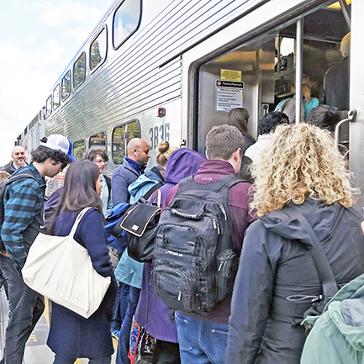
Future Engagement
Working with new consultant to help shape new community engagement plan
City Manager’s Office has identified the need for enhanced engagement with a panel of community representatives
Staff and new consultant will develop design and process for enhanced engagement for Council consideration

Slide 26
Connecting Palo Alto: Rail Program Master List of Ideas – Initial Screening
City Council
May 14, 2018

