Slide 1
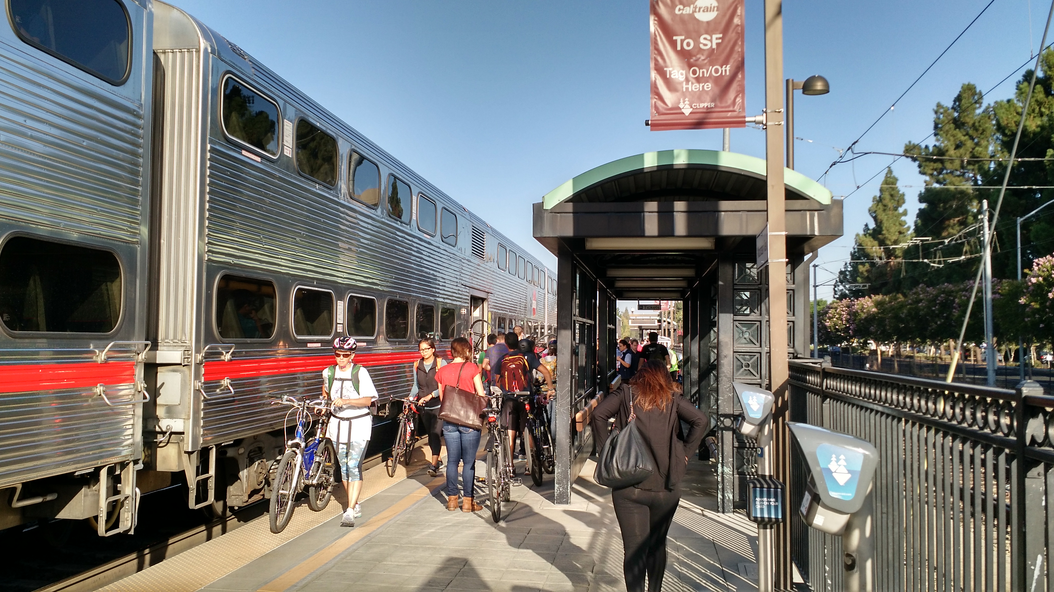
Connecting Palo Alto: Rail Program Master List of Ideas – Initial Screening
City Council Rail Committee
April 18, 2018

Slide 2
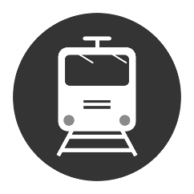
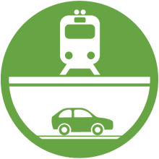
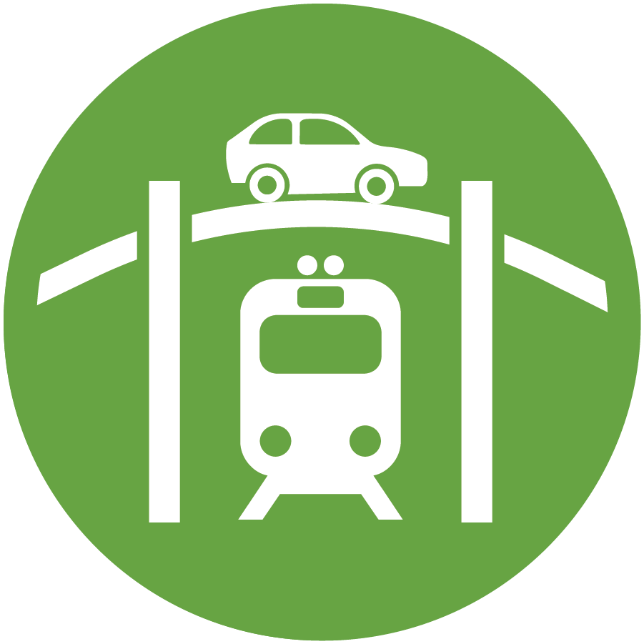
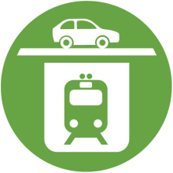
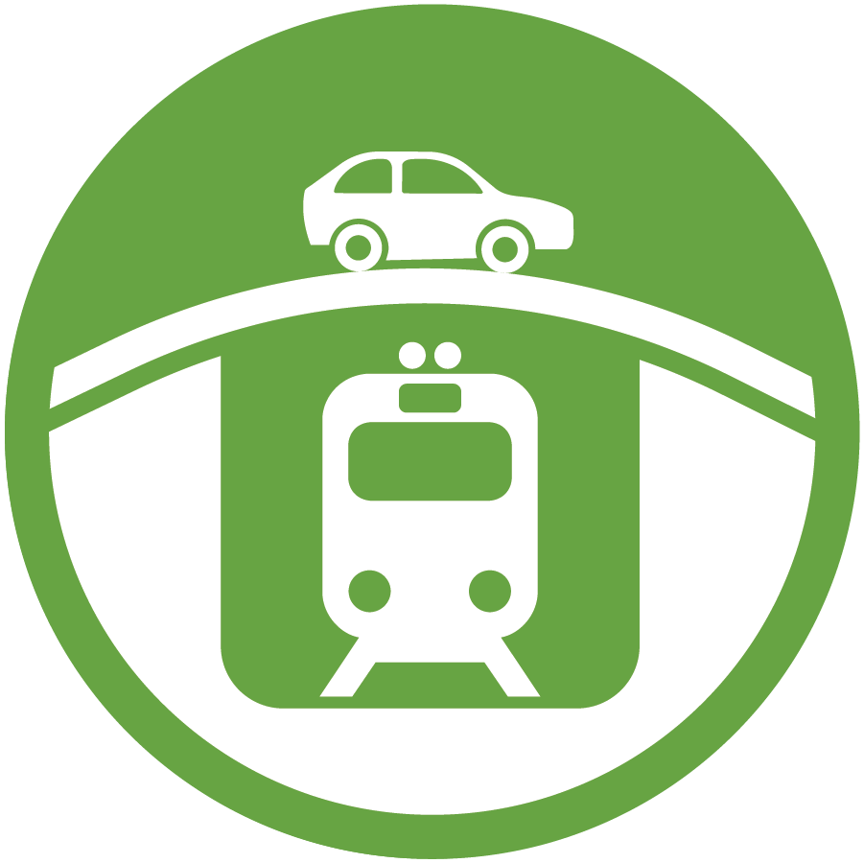
Potential Changes to Existing Crossings
INTERSECTIONS
Charleston Meadow
Churchill Palo Alto
No Build / Do Nothing
Closure
Road Under Rail
Road Over Rail
Hybrids
Rail Under Road
Rail Over Road
Closed to Vehicles Only; Pedestrians & Bicycles OK
Closed to All Traffic
Independent of Alma
Connects to Alma
Alma Below Grade
Alma at Grade

Slide 3
Mission for 2018
34 Ideas
Initial Screening of 34 Ideas
(Began in March)
4 - 8 Alternatives for Study (June)
1 Preferred Solution (December)

Slide 4
Master List of 34 Ideas from Community Meetings
Type of Separation (Alphabetical Order) | Citywide | Palo Alto | Churchill | Meadow | Charleston
Closure |  | Palo Alto Ave Closed - Everett Bike/Ped (PCE) - Widen University (PCU) - connect Alma Streets in Menlo Park (PCA) - extend Quarry Road to Alma (PCQ) | Churchill Ave Closed - Widen Embarcadero (CAE) - Seale Bike/Ped (CAS) - Kellogg Avenue Bike/Ped (CAK) | Meadow Dr Closed, Loma Verde Bike/Ped (MDL)
Hybrid (Road under Rail) |  | Palo Alto Ave Hybrid (PAH) | Churchill Ave Hybrid (CAH) | Meadow + Charleston Hybrid , Meadow + Charleston Loma Verde Bike/Ped (MCL) Hybrid (MCH)
 |  |  |  | Meadow Dr Hybrid (MDH) | Charleston Road Hybrid (CRH)
No Build / Do Nothing |  | Palo Alto Ave No Build, Safety Upgrades (PAN) | Churchill Ave No Build, Safety Upgrades (CAN) | Meadow Dr No Build - Safety Upgrades (MDN) - No connection to Alma (MDA)
Rail under Road (Trench) | Citywide Trench (WTR) |  | Churchill Ave Trench (CAT) | Meadow + Charleston Trench (MCT) Meadow + Charleston Trench, Alma in Trench (MCA) Meadow Dr Closed, Charleston Trench (MCX)
Rail under Road (Tunnel) | Citywide Deep Bore Tunnel - under El Camino Real (WBE) - under Rail Corridor (WBR) Citywide Cut & Cover Tunnel - under El Camino Real (WCE) - under Rail Corridor (WCR)
Rail over Road (Berm/Viaduct) | Citywide Railroad Berm (WER) Citywide Viaduct (WVR)
Road Over Rail |  |  |  |  | Charleston Rd Roadway Over Railroad (CRO)
Road under Rail |  | Connect Alma to Sand Hill Rd; dead-end Palo Alto Ave (PAT) |  | Meadow Dr Roadway Under Railroad (MDU) | Charleston Rd Road Under Rail - no connection to Alma (CRA) - connected to Alma (CRU)

Slide 5
Refining Process for Decisions
Tier 1 Criteria: Most Important
East-West connectivity: facilitate movement across the corridor for all modes of transportation
Traffic congestion: reduce delay and congestion for automobile traffic at rail crossings
Ped/Bike circulation: provide clear and safe routes for pedestrians and bicyclists seeking to cross the rail corridor, separate from automobile traffic
Rail operations: support continued rail operations and Caltrain service improvements
Cost: finance with feasible funding sources
Tier 2 Criteria: Also Important
Environmental impacts: reduce rail noise and vibration along the corridor
Environmental impacts: minimize visual changes along the rail corridor
Local access: maintain or improve access to neighborhoods, parks, schools and other destinations along the corridor while reducing regional traffic on neighborhood streets
Cost: minimize right-of-way acquisition by eminent domain
Construction: minimize disruption and the duration of construction
Technical
Financial
Adopted by City Council September 6, 2017
Property
Construc-
tion
Notes:
Council has adopted framework for evaluating alternatives, with specific criteria
Rather than review them individually, note major categories
Technical – functionality, intentional as well as unintended
Financial – cost can determine feasible or not, as well as options to fund
Property – again one line, but can determine feasibility given community impact of property acquisitions
Construction – fully understanding the impact of construction, including relocating Caltrain, noise, disruption, loss of trees and access

Slide 6
Evaluation Criteria with Sample Ideas
ID | Description of Alternative | Initial Screening Criteria |  |  |  |  |  |  |  |  |  |  |  | Advance into Study
 |  | Tier 1 |  |  |  |  | Tier 2 |  |  |  | New
 |  | Facilitate Movement - All Modes | Reduce Delay and Congestion | Ped-Bike Circulation | Support Rail Operations | Funding Feasibility | Reduce Noise | Minimize Visual Changes | Minimize Right-of-way | Minimize Construction Impacts | Estimated Community Support | Constructability | TAC Opinion
Alternatives
A | Grade Separation Idea A |  |  |  |  | X |  |  |  |  |  | X | ? | N
B | Grade Separation Idea B |  |  |  |  | ✔ |  |  |  |  |  | ✔ | ? | Y
C | Grade Separation Idea C |  |  |  |  | ✔ |  |  |  |  |  | X | ? | N
D | Grade Separation Idea D |  |  |  |  | X |  |  |  |  |  | X | ? | Y
E | Grade Separation Idea E |  |  |  |  | ✔ |  |  |  |  |  | X | ? | Y
Standard Scoring:
= Highest weight
= Middle weight
= Lowest weight
Fatal Flaw Scoring:
✔ = Feasible
X = Possibly Feasible
X = Not Feasible

Slide 7
Master List of 34 Ideas – Initial Screening
Type of Separation (Alphabetical Order) | Citywide | Palo Alto | Churchill | Meadow | Charleston
Closure |  | Palo Alto Ave Closed - Everett Bike/Ped (PCE) - Widen University (PCU) - connect Alma Streets in Menlo Park (PCA) - extend Quarry Road to Alma (PCQ) | Churchill Ave Closed - Widen Embarcadero (CAE) - Seale Bike/Ped (CAS) - Kellogg Avenue Bike/Ped (CAK) | Meadow Dr Closed, Loma Verde Bike/Ped (MDL)
Hybrid (Road under Rail) |  | Palo Alto Ave Hybrid (PAH) | Churchill Ave Hybrid (CAH) | Meadow + Charleston Hybrid , Meadow + Charleston Loma Verde Bike/Ped (MCL) Hybrid (MCH)
 |  |  |  | Meadow Dr Hybrid (MDH) | Charleston Road Hybrid (CRH)
No Build / Do Nothing |  | Palo Alto Ave No Build, Safety Upgrades (PAN) | Churchill Ave No Build, Safety Upgrades (CAN) | Meadow Dr No Build - Safety Upgrades (MDN) - No connection to Alma (MDA)
Rail under Road (Trench) | Citywide Trench (WTR) |  | Churchill Ave Trench (CAT) | Meadow + Charleston Trench (MCT) Meadow + Charleston Trench, Alma in Trench (MCA) Meadow Dr Closed, Charleston Trench (MCX)
Rail under Road (Tunnel) | Citywide Deep Bore Tunnel - under El Camino Real (WBE) - under Rail Corridor (WBR) Citywide Cut & Cover Tunnel - under El Camino Real (WCE) - under Rail Corridor (WCR)
Rail over Road (Berm/Viaduct) | Citywide Railroad Berm (WER) Citywide Viaduct (WVR)
Road Over Rail |  |  |  |  | Charleston Rd Roadway Over Railroad (CRO)
Road under Rail |  | Connect Alma to Sand Hill Rd; dead-end Palo Alto Ave (PAT) |  | Meadow Dr Roadway Under Railroad (MDU) | Charleston Rd Road Under Rail - no connection to Alma (CRA) - connected to Alma (CRU)

Slide 8
Master List of Ideas – Funding Feasibility Fatal Flaw
Type of Separation (Alphabetical Order) | Citywide | Palo Alto | Churchill | Meadow | Charleston
Closure |  | Palo Alto Ave Closed - Everett Bike/Ped (PCE) - Widen University (PCU) - connect Alma Streets in Menlo Park (PCA) - extend Quarry Road to Alma (PCQ) | Churchill Ave Closed - Widen Embarcadero (CAE) - Seale Bike/Ped (CAS) - Kellogg Avenue Bike/Ped (CAK) | Meadow Dr Closed, Loma Verde Bike/Ped (MDL)
Hybrid (Road under Rail) |  | Palo Alto Ave Hybrid (PAH) | Churchill Ave Hybrid (CAH) | Meadow + Charleston Hybrid , Meadow + Charleston Loma Verde Bike/Ped (MCL) Hybrid (MCH)
 |  |  |  | Meadow Dr Hybrid (MDH) | Charleston Road Hybrid (CRH)
No Build / Do Nothing |  | Palo Alto Ave No Build, Safety Upgrades (PAN) | Churchill Ave No Build, Safety Upgrades (CAN) | Meadow Dr No Build - Safety Upgrades (MDN) - No connection to Alma (MDA)
Rail under Road (Trench) | Citywide Trench (WTR) |  | Churchill Ave Trench (CAT) | Meadow + Charleston Trench (MCT) Meadow + Charleston Trench, Alma in Trench (MCA) Meadow Dr Closed, Charleston Trench (MCX)
Rail under Road (Tunnel) | Citywide Deep Bore Tunnel - under El Camino Real (WBE) - under Rail Corridor (WBR) Citywide Cut & Cover Tunnel - under El Camino Real (WCE) - under Rail Corridor (WCR)
Rail over Road (Berm/Viaduct) | Citywide Railroad Berm (WER) Citywide Viaduct (WVR)
Road Over Rail |  |  |  |  | Charleston Rd Roadway Over Railroad (CRO)
Road under Rail |  | Connect Alma to Sand Hill Rd; dead-end Palo Alto Ave (PAT) |  | Meadow Dr Roadway Under Railroad (MDU) | Charleston Rd Road Under Rail - no connection to Alma (CRA) - connected to Alma (CRU)

Slide 9
Master List of Ideas – Constructability Fatal Flaw
Type of Separation (Alphabetical Order) | Citywide | Palo Alto | Churchill | Meadow | Charleston
Closure |  | Palo Alto Ave Closed - Everett Bike/Ped (PCE) - Widen University (PCU) - connect Alma Streets in Menlo Park (PCA) - extend Quarry Road to Alma (PCQ) | Churchill Ave Closed - Widen Embarcadero (CAE) - Seale Bike/Ped (CAS) - Kellogg Avenue Bike/Ped (CAK) | Meadow Dr Closed, Loma Verde Bike/Ped (MDL)
Hybrid (Road under Rail) |  | Palo Alto Ave Hybrid (PAH) | Churchill Ave Hybrid (CAH) | Meadow + Charleston Hybrid , Meadow + Charleston Loma Verde Bike/Ped (MCL) Hybrid (MCH)
 |  |  |  | Meadow Dr Hybrid (MDH) | Charleston Road Hybrid (CRH)
No Build / Do Nothing |  | Palo Alto Ave No Build, Safety Upgrades (PAN) | Churchill Ave No Build, Safety Upgrades (CAN) | Meadow Dr No Build - Safety Upgrades (MDN) - No connection to Alma (MDA)
Rail under Road (Trench) | Citywide Trench (WTR) |  | Churchill Ave Trench (CAT) | Meadow + Charleston Trench (MCT) Meadow + Charleston Trench, Alma in Trench (MCA) Meadow Dr Closed, Charleston Trench (MCX)
Rail under Road (Tunnel) | Citywide Deep Bore Tunnel - under El Camino Real (WBE) - under Rail Corridor (WBR) Citywide Cut & Cover Tunnel - under El Camino Real (WCE) - under Rail Corridor (WCR)
Rail over Road (Berm/Viaduct) | Citywide Railroad Berm (WER) Citywide Viaduct (WVR)
Road Over Rail |  |  |  |  | Charleston Rd Roadway Over Railroad (CRO)
Road under Rail |  | Connect Alma to Sand Hill Rd; dead-end Palo Alto Ave (PAT) |  | Meadow Dr Roadway Under Railroad (MDU) | Charleston Rd Road Under Rail - no connection to Alma (CRA) - connected to Alma (CRU)

Slide 10
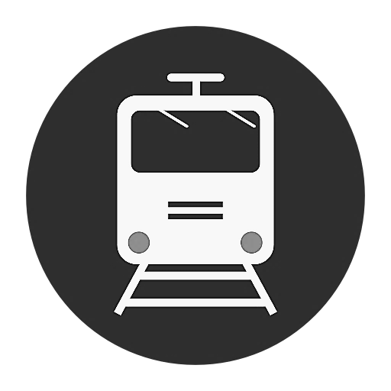
Results of Initial Screening = 16 Ideas
Type of Separation (Alphabetical Order) | Citywide | Palo Alto 2017 ADT (vehicles/day) = 16,200 (+ 550 bikes) | Churchill 2017 ADT (vehicles/day) = 9,200 (+ 1,020 bikes) | Meadow 2017 ADT (vehicles/day) = 8,900 (+ 900 bikes) | Charleston 2017 ADT (vehicles/day) = 17,900 (+ 240 bikes)
Closure |  | Palo Alto Ave Closed, Everett Bike/Ped (PCE) Palo Alto Ave Closed, Widen University (PCU) | Churchill Ave Closed, Widen Embarcadero (CAE) Churchill Ave Closed, Seale Bike/Ped (CAS) | Meadow Dr Closed, Loma Verde Bike/Ped (MDL)
Hybrid (Road under Rail) |  | Palo Alto Ave Hybrid (PAH) | Churchill Ave Hybrid (CAH) | Meadow + Charleston Meadow + Hybrid, Loma Verde Charleston Bike/Ped (MCL) Hybrid (MCH)
 |  |  |  | Meadow Dr Hybrid (MDH) | Charleston Road Hybrid (CRH)
No Build / Do Nothing |  | Palo Alto Ave No Build, Safety Upgrades (PAN) | Churchill Ave No Build, Safety Upgrades (CAN) | Meadow Dr No Build, Safety Upgrades (MDN)
Rail under Road (Trench) |  |  |  | Meadow + Charleston Meadow Dr Closed, Trench (MCT) Charleston Trench (MCX)
Rail under Road (Tunnel)
Rail over Road (Berm/Viaduct)
Road over Rail
Road under Rail
Notes:
Abbreviations
CAE – Close Churchill Ave. crossing, widen existing Embarcadero Rd. undercrossing
CAH – Churchill Ave. crossing with roadway under railroad Hybrid
CAN – Churchill Ave. crossing with No grade separation. Implement minor safety improvements
CAS − Close Churchill Ave. crossing, build bike/ped crossing near planned Seale Ave. bike boulevard to connect to Peers Park and Stanford Ave. bike boulevard
CRH − Charleston Rd. crossing with Hybrid (maintain connection b/w Charleston Rd. and Alma St.)
MCH − Meadow Dr. and Charleston Rd. crossings with roadway under rail Hybrid
MCL − Meadow Dr. and Charleston Rd crossings with roadway under rail Hybrid; new hybrid bike/ped path under rail near Loma Verde Ave.
MCT − Meadow Dr. to Charleston Rd Trench; Alma St. not within trench (maintain connections between Meadow Dr. and Charleston Rd.)
MCX − Close Meadow Dr. crossing; Railroad under roadway trench at Charleston Rd.; Alma St not (X) in trench (maintain connection b/w Meadow Dr. and Charleston Rd.)
MDH − Meadow Dr. crossing with roadway under railroad Hybrid (maintain connection b/w Meadow Dr. & Alma St.)
MDL − Close Meadow Dr. crossing, build bike/ped crossing near Loma Verde Ave. to connect to planned Matadero Ave. bike boulevard
MDN − Meadow Dr. crossing with No grade separation; implement safety improvements
PAH − Continue proposed Menlo Park Hybrid across San Francisquito Creek and Palo Alto Ave. on a viaduct structure
PAN − Palo Alto Ave. crossing with No grade separation; implement safety improvements (quad-gates and wayside horns) with the goal of making a quiet zone
PCE − Palo Alto Ave. crossing Closed; build Everett Ave. bike/ped undercrossing
PCU − Palo Alto Ave. crossing Closed; widen University Ave. roadway undercrossing

Slide 11
Rail Committee Feedback (March 21, 2018)
Council Member Fine moved, seconded by Council Member Scharff to recommend to the City Council to ask Staff to consider these points going forward:
1) To consider the clarity of freight issues;
2) Property takings;
3) Separation of bike and pedestrian issues; and
4) The station plans or effects.
Other issues needing more clarity include:
Circulation impacts
1% vs. 2% grade allowance
Visuals of what the ideas look like
Funding feasibility
Initial Screening of 34 Ideas
Discuss further on April 18 and make a motion to recommend 16
Combine some of the discreet ideas and include a list of improvement options

Slide 12
Technical Advisory Committee Feedback
The breadth of ideas being explored is good and provides a robust level of analysis
Traffic analysis would be helpful, especially for closures
No build options may not be realistic or feasible
The impact of high speed rail could be significant
No build options were not considered for Measure B funding
Pedestrian and Bicycle Crossings
Plans should consider the wider impact on the network.
The most important attribute to the city bike/ped network is the distance between crossings of the rail corridor.
Do grade separation options help with other problems?
Public Safety Response Times - need to factor into decisions, especially with regards to Closures
Detailed Right of Way Impacts are not available until a full analysis is conducted

Slide 13
Summary of Response of the At-Grade Intersections to Change
 | Remain at-grade | Closed | Grade-separated
Palo Alto Ave / Alma St | Little effect | Sheds small amount of traffic to Ravenswood Ave and University Ave | Significantly increases traffic flows. (~30%)
Churchill Ave | Little effect | Considerable diversion to Embarcadero Rd, which if widened could operate satisfactorily. | It is suspected that there would be little effect on other grade crossings, if other separations implemented. Could attract small amounts of traffic.
E/W Meadow Drive | As traffic grows, will shed to Oregon Expressway and Charleston Rd (if grade separated) | Some diversion to Charleston Road; significant if Charleston is grade-separated | Significantly increases traffic flows (~50%)
Charleston Rd | As traffic grows, will shed to San Antonio Road | Not tested but likely to either shed significant traffic to San Antonio Road or reduce traffic overall | Significant increases to traffic flows (50+%). Some diverts from San Antonio Rd.
Condition
Location
Notes:
.

Slide 14
Results of Initial Screening = 16 Ideas
Type of Separation (Alphabetical Order) | Citywide | Palo Alto 2017 ADT (vehicles/day) = 16,200 (+ 550 bikes) | Churchill 2017 ADT (vehicles/day) = 9,200 (+ 1,020 bikes) | Meadow 2017 ADT (vehicles/day) = 8,900 (+ 900 bikes) | Charleston 2017 ADT (vehicles/day) = 17,900 (+ 240 bikes)
Closure |  | Palo Alto Ave Closed, Everett Bike/Ped (PCE) Palo Alto Ave Closed, Widen University (PCU) | Churchill Ave Closed, Widen Embarcadero (CAE) Churchill Ave Closed, Seale Bike/Ped (CAS) | Meadow Dr Closed, Loma Verde Bike/Ped (MDL)
Hybrid (Road under Rail) |  | Palo Alto Ave Hybrid (PAH) | Churchill Ave Hybrid (CAH) | Meadow + Charleston Meadow + Hybrid, Loma Verde Charleston Bike/Ped (MCL) Hybrid (MCH)
 |  |  |  | Meadow Dr Hybrid (MDH) | Charleston Road Hybrid (CRH)
No Build / Do Nothing |  | Palo Alto Ave No Build, Safety Upgrades (PAN) | Churchill Ave No Build, Safety Upgrades (CAN) | Meadow Dr No Build, Safety Upgrades (MDN)
Rail under Road (Trench) |  |  |  | Meadow + Charleston Meadow Dr Closed, Trench (MCT) Charleston Trench (MCX)
Rail under Road (Tunnel)
Rail over Road (Berm/Viaduct)
Road over Rail
Road under Rail
Notes:
Abbreviations
CAE – Close Churchill Ave. crossing, widen existing Embarcadero Rd. undercrossing
CAH – Churchill Ave. crossing with roadway under railroad Hybrid
CAN – Churchill Ave. crossing with No grade separation. Implement minor safety improvements
CAS − Close Churchill Ave. crossing, build bike/ped crossing near planned Seale Ave. bike boulevard to connect to Peers Park and Stanford Ave. bike boulevard
CRH − Charleston Rd. crossing with Hybrid (maintain connection b/w Charleston Rd. and Alma St.)
MCH − Meadow Dr. and Charleston Rd. crossings with roadway under rail Hybrid
MCL − Meadow Dr. and Charleston Rd crossings with roadway under rail Hybrid; new hybrid bike/ped path under rail near Loma Verde Ave.
MCT − Meadow Dr. to Charleston Rd Trench; Alma St. not within trench (maintain connections between Meadow Dr. and Charleston Rd.)
MCX − Close Meadow Dr. crossing; Railroad under roadway trench at Charleston Rd.; Alma St not (X) in trench (maintain connection b/w Meadow Dr. and Charleston Rd.)
MDH − Meadow Dr. crossing with roadway under railroad Hybrid (maintain connection b/w Meadow Dr. & Alma St.)
MDL − Close Meadow Dr. crossing, build bike/ped crossing near Loma Verde Ave. to connect to planned Matadero Ave. bike boulevard
MDN − Meadow Dr. crossing with No grade separation; implement safety improvements
PAH − Continue proposed Menlo Park Hybrid across San Francisquito Creek and Palo Alto Ave. on a viaduct structure
PAN − Palo Alto Ave. crossing with No grade separation; implement safety improvements (quad-gates and wayside horns) with the goal of making a quiet zone
PCE − Palo Alto Ave. crossing Closed; build Everett Ave. bike/ped undercrossing
PCU − Palo Alto Ave. crossing Closed; widen University Ave. roadway undercrossing

Slide 15
Options for Initial Screening - Keep No Builds?
Type of Separation (Alphabetical Order) | Citywide | Palo Alto 2017 ADT (vehicles/day) = 16,200 (+ 550 bikes) | Churchill 2017 ADT (vehicles/day) = 9,200 (+ 1,020 bikes) | Meadow 2017 ADT (vehicles/day) = 8,900 (+ 900 bikes) | Charleston 2017 ADT (vehicles/day) = 17,900 (+ 240 bikes)
Closure |  | Palo Alto Ave Closed, Everett Bike/Ped (PCE) Palo Alto Ave Closed, Widen University (PCU) | Churchill Ave Closed, Widen Embarcadero (CAE) Churchill Ave Closed, Seale Bike/Ped (CAS) | Meadow Dr Closed, Loma Verde Bike/Ped (MDL)
Hybrid (Road under Rail) |  | Palo Alto Ave Hybrid (PAH) | Churchill Ave Hybrid (CAH) | Meadow + Charleston Meadow + Hybrid, Loma Verde Charleston Bike/Ped (MCL) Hybrid (MCH)
 |  |  |  | Meadow Dr Hybrid (MDH) | Charleston Road Hybrid (CRH)
No Build / Do Nothing |  | Palo Alto Ave No Build, Safety Upgrades (PAN) | Churchill Ave No Build, Safety Upgrades (CAN) | Meadow Dr No Build, Safety Upgrades (MDN)
Rail under Road (Trench) |  |  |  | Meadow + Charleston Meadow Dr Closed, Trench (MCT) Charleston Trench (MCX)
Rail under Road (Tunnel)
Rail over Road (Berm/Viaduct)
Road over Rail
Road under Rail
No Build Options may not be realistic or feasible, but CEQA requires them to be considered
Notes:
Abbreviations
CAE – Close Churchill Ave. crossing, widen existing Embarcadero Rd. undercrossing
CAH – Churchill Ave. crossing with roadway under railroad Hybrid
CAN – Churchill Ave. crossing with No grade separation. Implement minor safety improvements
CAS − Close Churchill Ave. crossing, build bike/ped crossing near planned Seale Ave. bike boulevard to connect to Peers Park and Stanford Ave. bike boulevard
CRH − Charleston Rd. crossing with Hybrid (maintain connection b/w Charleston Rd. and Alma St.)
MCH − Meadow Dr. and Charleston Rd. crossings with roadway under rail Hybrid
MCL − Meadow Dr. and Charleston Rd crossings with roadway under rail Hybrid; new hybrid bike/ped path under rail near Loma Verde Ave.
MCT − Meadow Dr. to Charleston Rd Trench; Alma St. not within trench (maintain connections between Meadow Dr. and Charleston Rd.)
MCX − Close Meadow Dr. crossing; Railroad under roadway trench at Charleston Rd.; Alma St not (X) in trench (maintain connection b/w Meadow Dr. and Charleston Rd.)
MDH − Meadow Dr. crossing with roadway under railroad Hybrid (maintain connection b/w Meadow Dr. & Alma St.)
MDL − Close Meadow Dr. crossing, build bike/ped crossing near Loma Verde Ave. to connect to planned Matadero Ave. bike boulevard
MDN − Meadow Dr. crossing with No grade separation; implement safety improvements
PAH − Continue proposed Menlo Park Hybrid across San Francisquito Creek and Palo Alto Ave. on a viaduct structure
PAN − Palo Alto Ave. crossing with No grade separation; implement safety improvements (quad-gates and wayside horns) with the goal of making a quiet zone
PCE − Palo Alto Ave. crossing Closed; build Everett Ave. bike/ped undercrossing
PCU − Palo Alto Ave. crossing Closed; widen University Ave. roadway undercrossing

Slide 16
Options for Initial Screening – Remove Unnecessary
Type of Separation (Alphabetical Order) | Citywide | Palo Alto 2017 ADT (vehicles/day) = 16,200 (+ 550 bikes) | Churchill 2017 ADT (vehicles/day) = 9,200 (+ 1,020 bikes) | Meadow 2017 ADT (vehicles/day) = 8,900 (+ 900 bikes) | Charleston 2017 ADT (vehicles/day) = 17,900 (+ 240 bikes)
Closure |  | Palo Alto Ave Closed, Everett Bike/Ped (PCE) Palo Alto Ave Closed, Widen University (PCU) | Churchill Ave Closed, Widen Embarcadero (CAE) Churchill Ave Closed, Seale Bike/Ped (CAS) | Meadow Dr Closed, Loma Verde Bike/Ped (MDL)
Hybrid (Road under Rail) |  | Palo Alto Ave Hybrid (PAH) | Churchill Ave Hybrid (CAH) | Meadow + Charleston Meadow + Hybrid, Loma Verde Charleston Bike/Ped (MCL) Hybrid (MCH)
 |  |  |  | Meadow Dr Hybrid (MDH) | Charleston Road Hybrid (CRH)
No Build / Do Nothing |  | Palo Alto Ave No Build, Safety Upgrades (PAN) | Churchill Ave No Build, Safety Upgrades (CAN) | Meadow Dr No Build, Safety Upgrades (MDN)
Rail under Road (Trench) |  |  |  | Meadow + Charleston Meadow Dr Closed, Trench (MCT) Charleston Trench (MCX)
Rail under Road (Tunnel)
Rail over Road (Berm/Viaduct)
Road over Rail
Road under Rail
No design benefit compared to MCT. A 2% grade is still required south of Charleston Rd.
Notes:
Abbreviations
CAE – Close Churchill Ave. crossing, widen existing Embarcadero Rd. undercrossing
CAH – Churchill Ave. crossing with roadway under railroad Hybrid
CAN – Churchill Ave. crossing with No grade separation. Implement minor safety improvements
CAS − Close Churchill Ave. crossing, build bike/ped crossing near planned Seale Ave. bike boulevard to connect to Peers Park and Stanford Ave. bike boulevard
CRH − Charleston Rd. crossing with Hybrid (maintain connection b/w Charleston Rd. and Alma St.)
MCH − Meadow Dr. and Charleston Rd. crossings with roadway under rail Hybrid
MCL − Meadow Dr. and Charleston Rd crossings with roadway under rail Hybrid; new hybrid bike/ped path under rail near Loma Verde Ave.
MCT − Meadow Dr. to Charleston Rd Trench; Alma St. not within trench (maintain connections between Meadow Dr. and Charleston Rd.)
MCX − Close Meadow Dr. crossing; Railroad under roadway trench at Charleston Rd.; Alma St not (X) in trench (maintain connection b/w Meadow Dr. and Charleston Rd.)
MDH − Meadow Dr. crossing with roadway under railroad Hybrid (maintain connection b/w Meadow Dr. & Alma St.)
MDL − Close Meadow Dr. crossing, build bike/ped crossing near Loma Verde Ave. to connect to planned Matadero Ave. bike boulevard
MDN − Meadow Dr. crossing with No grade separation; implement safety improvements
PAH − Continue proposed Menlo Park Hybrid across San Francisquito Creek and Palo Alto Ave. on a viaduct structure
PAN − Palo Alto Ave. crossing with No grade separation; implement safety improvements (quad-gates and wayside horns) with the goal of making a quiet zone
PCE − Palo Alto Ave. crossing Closed; build Everett Ave. bike/ped undercrossing
PCU − Palo Alto Ave. crossing Closed; widen University Ave. roadway undercrossing

Slide 17
Options for Initial Screening – Combine Adjacent
Type of Separation (Alphabetical Order) | Citywide | Palo Alto 2017 ADT (vehicles/day) = 16,200 (+ 550 bikes) | Churchill 2017 ADT (vehicles/day) = 9,200 (+ 1,020 bikes) | Meadow 2017 ADT (vehicles/day) = 8,900 (+ 900 bikes) | Charleston 2017 ADT (vehicles/day) = 17,900 (+ 240 bikes)
Closure |  | Palo Alto Ave Closed, Everett Bike/Ped (PCE) Palo Alto Ave Closed, Widen University (PCU) | Churchill Ave Closed, Widen Embarcadero (CAE) Churchill Ave Closed, Seale Bike/Ped (CAS) | Meadow Dr Closed, Loma Verde Bike/Ped (MDL)
Hybrid (Road under Rail) |  | Palo Alto Ave Hybrid (PAH) | Churchill Ave Hybrid (CAH) | Meadow + Charleston Meadow + Hybrid, Loma Verde Charleston Bike/Ped (MCL) Hybrid (MCH)
 |  |  |  | Meadow Dr Hybrid (MDH) | Charleston Road Hybrid (CRH)
No Build / Do Nothing |  | Palo Alto Ave No Build, Safety Upgrades (PAN) | Churchill Ave No Build, Safety Upgrades (CAN) | Meadow Dr No Build, Safety Upgrades (MDN)
Rail under Road (Trench) |  |  |  | Meadow + Charleston Meadow Dr Closed, Trench (MCT) Charleston Trench (MCX)
Rail under Road (Tunnel)
Rail over Road (Berm/Viaduct)
Road over Rail
Road under Rail
No design benefit to closing Meadow without addressing Charleston Rd.
No design benefit when compared to hybrid option that includes both Meadow Dr. and Charleston Rd.
No design benefit when compared to hybrid option that includes both Meadow Dr. and Charleston Rd.
Notes:
Abbreviations
CAE – Close Churchill Ave. crossing, widen existing Embarcadero Rd. undercrossing
CAH – Churchill Ave. crossing with roadway under railroad Hybrid
CAN – Churchill Ave. crossing with No grade separation. Implement minor safety improvements
CAS − Close Churchill Ave. crossing, build bike/ped crossing near planned Seale Ave. bike boulevard to connect to Peers Park and Stanford Ave. bike boulevard
CRH − Charleston Rd. crossing with Hybrid (maintain connection b/w Charleston Rd. and Alma St.)
MCH − Meadow Dr. and Charleston Rd. crossings with roadway under rail Hybrid
MCL − Meadow Dr. and Charleston Rd crossings with roadway under rail Hybrid; new hybrid bike/ped path under rail near Loma Verde Ave.
MCT − Meadow Dr. to Charleston Rd Trench; Alma St. not within trench (maintain connections between Meadow Dr. and Charleston Rd.)
MCX − Close Meadow Dr. crossing; Railroad under roadway trench at Charleston Rd.; Alma St not (X) in trench (maintain connection b/w Meadow Dr. and Charleston Rd.)
MDH − Meadow Dr. crossing with roadway under railroad Hybrid (maintain connection b/w Meadow Dr. & Alma St.)
MDL − Close Meadow Dr. crossing, build bike/ped crossing near Loma Verde Ave. to connect to planned Matadero Ave. bike boulevard
MDN − Meadow Dr. crossing with No grade separation; implement safety improvements
PAH − Continue proposed Menlo Park Hybrid across San Francisquito Creek and Palo Alto Ave. on a viaduct structure
PAN − Palo Alto Ave. crossing with No grade separation; implement safety improvements (quad-gates and wayside horns) with the goal of making a quiet zone
PCE − Palo Alto Ave. crossing Closed; build Everett Ave. bike/ped undercrossing
PCU − Palo Alto Ave. crossing Closed; widen University Ave. roadway undercrossing

Slide 18
Options for Initial Screening – Merge Overlapping
Type of Separation (Alphabetical Order) | Citywide | Palo Alto 2017 ADT (vehicles/day) = 16,200 (+ 550 bikes) | Churchill 2017 ADT (vehicles/day) = 9,200 (+ 1,020 bikes) | Meadow 2017 ADT (vehicles/day) = 8,900 (+ 900 bikes) | Charleston 2017 ADT (vehicles/day) = 17,900 (+ 240 bikes)
Closure |  | Palo Alto Ave Closed, Everett Bike/Ped (PCE) Palo Alto Ave Closed, Widen University (PCU) | Churchill Ave Closed, Widen Embarcadero (CAE) Churchill Ave Closed, Seale Bike/Ped (CAS) | Meadow Dr Closed, Loma Verde Bike/Ped (MDL)
Hybrid (Road under Rail) |  | Palo Alto Ave Hybrid (PAH) | Churchill Ave Hybrid (CAH) | Meadow + Charleston Meadow + Hybrid, Loma Verde Charleston Bike/Ped (MCL) Hybrid (MCH)
 |  |  |  | Meadow Dr Hybrid (MDH) | Charleston Road Hybrid (CRH)
No Build / Do Nothing |  | Palo Alto Ave No Build, Safety Upgrades (PAN) | Churchill Ave No Build, Safety Upgrades (CAN) | Meadow Dr No Build, Safety Upgrades (MDN)
Rail under Road (Trench) |  |  |  | Meadow + Charleston Meadow Dr Closed, Trench (MCT) Charleston Trench (MCX)
Rail under Road (Tunnel)
Rail over Road (Berm/Viaduct)
Road over Rail
Road under Rail
Merge MCH with MCL - No design benefit compared to MCL
Notes:
Abbreviations
CAE – Close Churchill Ave. crossing, widen existing Embarcadero Rd. undercrossing
CAH – Churchill Ave. crossing with roadway under railroad Hybrid
CAN – Churchill Ave. crossing with No grade separation. Implement minor safety improvements
CAS − Close Churchill Ave. crossing, build bike/ped crossing near planned Seale Ave. bike boulevard to connect to Peers Park and Stanford Ave. bike boulevard
CRH − Charleston Rd. crossing with Hybrid (maintain connection b/w Charleston Rd. and Alma St.)
MCH − Meadow Dr. and Charleston Rd. crossings with roadway under rail Hybrid
MCL − Meadow Dr. and Charleston Rd crossings with roadway under rail Hybrid; new hybrid bike/ped path under rail near Loma Verde Ave.
MCT − Meadow Dr. to Charleston Rd Trench; Alma St. not within trench (maintain connections between Meadow Dr. and Charleston Rd.)
MCX − Close Meadow Dr. crossing; Railroad under roadway trench at Charleston Rd.; Alma St not (X) in trench (maintain connection b/w Meadow Dr. and Charleston Rd.)
MDH − Meadow Dr. crossing with roadway under railroad Hybrid (maintain connection b/w Meadow Dr. & Alma St.)
MDL − Close Meadow Dr. crossing, build bike/ped crossing near Loma Verde Ave. to connect to planned Matadero Ave. bike boulevard
MDN − Meadow Dr. crossing with No grade separation; implement safety improvements
PAH − Continue proposed Menlo Park Hybrid across San Francisquito Creek and Palo Alto Ave. on a viaduct structure
PAN − Palo Alto Ave. crossing with No grade separation; implement safety improvements (quad-gates and wayside horns) with the goal of making a quiet zone
PCE − Palo Alto Ave. crossing Closed; build Everett Ave. bike/ped undercrossing
PCU − Palo Alto Ave. crossing Closed; widen University Ave. roadway undercrossing

Slide 19
Options for Initial Screening – Combine Similar
Type of Separation (Alphabetical Order) | Citywide | Palo Alto 2017 ADT (vehicles/day) = 16,200 (+ 550 bikes) | Churchill 2017 ADT (vehicles/day) = 9,200 (+ 1,020 bikes) | Meadow 2017 ADT (vehicles/day) = 8,900 (+ 900 bikes) | Charleston 2017 ADT (vehicles/day) = 17,900 (+ 240 bikes)
Closure |  | Palo Alto Ave Closed, Everett Bike/Ped (PCE) Palo Alto Ave Closed, Widen University (PCU) | Churchill Ave Closed, Widen Embarcadero (CAE) Churchill Ave Closed, Seale Bike/Ped (CAS) | Meadow Dr Closed, Loma Verde Bike/Ped (MDL)
Hybrid (Road under Rail) |  | Palo Alto Ave Hybrid (PAH) | Churchill Ave Hybrid (CAH) | Meadow + Charleston Meadow + Hybrid, Loma Verde Charleston Bike/Ped (MCL) Hybrid (MCH)
 |  |  |  | Meadow Dr Hybrid (MDH) | Charleston Road Hybrid (CRH)
No Build / Do Nothing |  | Palo Alto Ave No Build, Safety Upgrades (PAN) | Churchill Ave No Build, Safety Upgrades (CAN) | Meadow Dr No Build, Safety Upgrades (MDN)
Rail under Road (Trench) |  |  |  | Meadow + Charleston Meadow Dr Closed, Trench (MCT) Charleston Trench (MCX)
Rail under Road (Tunnel)
Rail over Road (Berm/Viaduct)
Road over Rail
Road under Rail
Combine PCE and PCU into PCX, with a list of possible improvement options to choose from
Combine CAE and CAS into CAX, with a list of possible improvement options to choose from
Notes:
Abbreviations
CAE – Close Churchill Ave. crossing, widen existing Embarcadero Rd. undercrossing
CAH – Churchill Ave. crossing with roadway under railroad Hybrid
CAN – Churchill Ave. crossing with No grade separation. Implement minor safety improvements
CAS − Close Churchill Ave. crossing, build bike/ped crossing near planned Seale Ave. bike boulevard to connect to Peers Park and Stanford Ave. bike boulevard
CRH − Charleston Rd. crossing with Hybrid (maintain connection b/w Charleston Rd. and Alma St.)
MCH − Meadow Dr. and Charleston Rd. crossings with roadway under rail Hybrid
MCL − Meadow Dr. and Charleston Rd crossings with roadway under rail Hybrid; new hybrid bike/ped path under rail near Loma Verde Ave.
MCT − Meadow Dr. to Charleston Rd Trench; Alma St. not within trench (maintain connections between Meadow Dr. and Charleston Rd.)
MCX − Close Meadow Dr. crossing; Railroad under roadway trench at Charleston Rd.; Alma St not (X) in trench (maintain connection b/w Meadow Dr. and Charleston Rd.)
MDH − Meadow Dr. crossing with roadway under railroad Hybrid (maintain connection b/w Meadow Dr. & Alma St.)
MDL − Close Meadow Dr. crossing, build bike/ped crossing near Loma Verde Ave. to connect to planned Matadero Ave. bike boulevard
MDN − Meadow Dr. crossing with No grade separation; implement safety improvements
PAH − Continue proposed Menlo Park Hybrid across San Francisquito Creek and Palo Alto Ave. on a viaduct structure
PAN − Palo Alto Ave. crossing with No grade separation; implement safety improvements (quad-gates and wayside horns) with the goal of making a quiet zone
PCE − Palo Alto Ave. crossing Closed; build Everett Ave. bike/ped undercrossing
PCU − Palo Alto Ave. crossing Closed; widen University Ave. roadway undercrossing

Slide 20
Options for Initial Screening – Add TAC Suggestion
Type of Separation (Alphabetical Order) | Citywide | Palo Alto 2017 ADT (vehicles/day) = 16,200 (+ 550 bikes) | Churchill 2017 ADT (vehicles/day) = 9,200 (+ 1,020 bikes) | Meadow 2017 ADT (vehicles/day) = 8,900 (+ 900 bikes) | Charleston 2017 ADT (vehicles/day) = 17,900 (+ 240 bikes)
Closure |  | Palo Alto Ave Closed, Everett Bike/Ped (PCE) Palo Alto Ave Closed, Widen University (PCU) | Churchill Ave Closed, Widen Embarcadero (CAE) Churchill Ave Closed, Seale Bike/Ped (CAS) | Meadow Dr Closed, Loma Verde Bike/Ped (MDL)
Hybrid (Road under Rail) |  | Palo Alto Ave Hybrid (PAH) | Churchill Ave Hybrid (CAH) | Meadow + Charleston Meadow + Hybrid, Loma Verde Charleston Bike/Ped (MCL) Hybrid (MCH)
 |  |  |  | Meadow Dr Hybrid (MDH) | Charleston Road Hybrid (CRH)
No Build / Do Nothing |  | Palo Alto Ave No Build, Safety Upgrades (PAN) | Churchill Ave No Build, Safety Upgrades (CAN) | Meadow Dr No Build, Safety Upgrades (MDN)
Rail under Road (Trench) |  |  |  | Meadow + Charleston Meadow Dr Closed, Trench (MCT) Charleston Trench (MCX)
Rail under Road (Tunnel)
Rail over Road (Berm/Viaduct)
Road over Rail
Road under Rail
PCX
CAX
Caltrain recommends exploring both a Road over Rail Hybrid as well as a Road under Rail Hybrid
Notes:
Abbreviations
CAE – Close Churchill Ave. crossing, widen existing Embarcadero Rd. undercrossing
CAH – Churchill Ave. crossing with roadway under railroad Hybrid
CAN – Churchill Ave. crossing with No grade separation. Implement minor safety improvements
CAS − Close Churchill Ave. crossing, build bike/ped crossing near planned Seale Ave. bike boulevard to connect to Peers Park and Stanford Ave. bike boulevard
CRH − Charleston Rd. crossing with Hybrid (maintain connection b/w Charleston Rd. and Alma St.)
MCH − Meadow Dr. and Charleston Rd. crossings with roadway under rail Hybrid
MCL − Meadow Dr. and Charleston Rd crossings with roadway under rail Hybrid; new hybrid bike/ped path under rail near Loma Verde Ave.
MCT − Meadow Dr. to Charleston Rd Trench; Alma St. not within trench (maintain connections between Meadow Dr. and Charleston Rd.)
MCX − Close Meadow Dr. crossing; Railroad under roadway trench at Charleston Rd.; Alma St not (X) in trench (maintain connection b/w Meadow Dr. and Charleston Rd.)
MDH − Meadow Dr. crossing with roadway under railroad Hybrid (maintain connection b/w Meadow Dr. & Alma St.)
MDL − Close Meadow Dr. crossing, build bike/ped crossing near Loma Verde Ave. to connect to planned Matadero Ave. bike boulevard
MDN − Meadow Dr. crossing with No grade separation; implement safety improvements
PAH − Continue proposed Menlo Park Hybrid across San Francisquito Creek and Palo Alto Ave. on a viaduct structure
PAN − Palo Alto Ave. crossing with No grade separation; implement safety improvements (quad-gates and wayside horns) with the goal of making a quiet zone
PCE − Palo Alto Ave. crossing Closed; build Everett Ave. bike/ped undercrossing
PCU − Palo Alto Ave. crossing Closed; widen University Ave. roadway undercrossing

Slide 21
Selecting All Options = 10 Ideas
Type of Separation (Alphabetical Order) | Citywide | Palo Alto 2017 ADT (vehicles/day) = 16,200 (+ 550 bikes) | Churchill 2017 ADT (vehicles/day) = 9,200 (+ 1,020 bikes) | Meadow 2017 ADT (vehicles/day) = 8,900 (+ 900 bikes) | Charleston 2017 ADT (vehicles/day) = 17,900 (+ 240 bikes)
Closure |  | Palo Alto Ave Closed, Add Improvements (PCX) | Churchill Ave Closed, Add Improvements (CAX)
Hybrid (Road over Rail) |  |  |  | Meadow + Charleston Road Over Rail Hybrid, Loma Verde Bike/Ped (MCR)
Hybrid (Road under Rail) |  | Palo Alto Ave Hybrid (PAH) | Churchill Ave Hybrid (CAH) | Meadow + Charleston Road Under Rail Hybrid, Loma Verde Bike/Ped (MCL)
No Build / Do Nothing |  | Palo Alto Ave No Build, Safety Upgrades (PAN) | Churchill Ave No Build, Safety Upgrades (CAN) | Meadow Dr No Build, Safety Upgrades (MDN)
Rail under Road (Trench) |  |  |  | Meadow + Charleston Trench (MCT)
Rail under Road (Tunnel)
Rail over Road (Berm/Viaduct)
Road Over Rail
Road under Rail
Notes:
Abbreviations
CAX – Churchill Ave. crossing closed (X); Improvement options include: widen existing Embarcadero Rd. undercrossing, add new traffic signals at Embarcadero Rd. ramp, and build bike/ped crossing near planned Seale Ave. bike boulevard to connect to Peers Park and Stanford Ave. bike boulevard
CAH – Churchill Ave. crossing with roadway under railroad Hybrid
MCL − Meadow Dr. and Charleston Rd crossings with roadway under rail Hybrid; new hybrid bike/ped path under rail near Loma Verde Ave.
MCR − Meadow Dr. and Charleston Rd crossings with Roadway over rail Hybrid; new hybrid bike/ped path under rail near Loma Verde Ave.
MCT − Meadow Dr. to Charleston Rd Trench; Alma St. not within trench (maintain connections between Meadow Dr. and Charleston Rd.)
PAH − Continue proposed Menlo Park Hybrid across San Francisquito Creek and Palo Alto Ave. on a viaduct structure
PCX − Palo Alto Ave. Crossing closed (X); Improvement options include: build Everett Ave. bike/ped undercrossing and widen University Ave.

Slide 22
Connecting Palo Alto: Rail Program Master List of Ideas – Initial Screening
City Council Rail Committee
April 18, 2018

