Slide 1
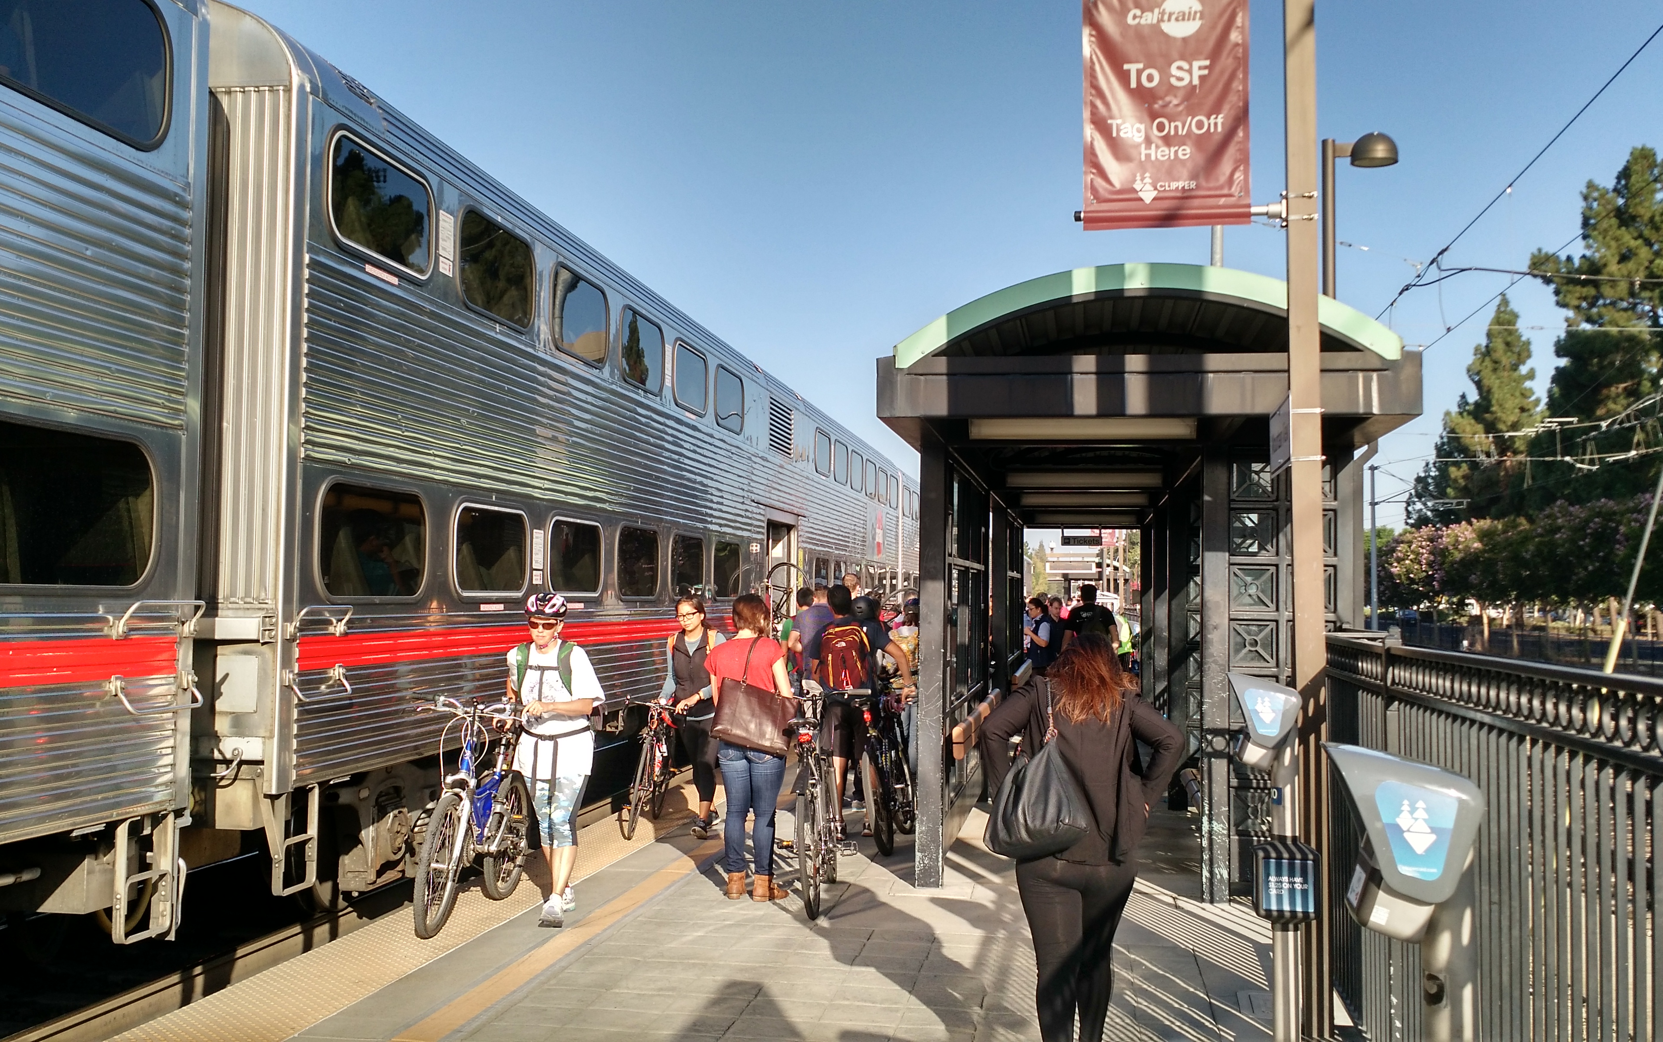
Report No. 1 of the Rail Corridor Circulation Studies: Sample Scenarios 1 - 6
Josh Mello
Chief Transportation Official

Slide 2
Contents
Introduction & Background
Impacts Under “No Build” Scenarios
Testing the 6 Sample Scenarios
Motor Vehicles
Testing the 6 Sample Scenarios
Bicycles & Pedestrians
Road Collisions

Slide 3
Introduction & Background

Slide 4
Traffic Circulation Study
Overview of Study being performed
Assessing ‘what if’ scenarios related to alternatives at Palo Alto; Churchill; Meadow; Charleston
Do nothing
Close completely
Bikes/Peds separated crossing only
Full grade separation
Mix and match alternatives

Slide 5
Traffic Circulation Study – At Grade Crossings
Methodology of Study
2017 traffic counts
Volume Growth based on regional projections (MTC/VTA)
“Best Practices” assignments for growth and traffic diversion
Two model approach:
Palo Alto Travel Demand Model (regional => projected volumes)
Traffic Operational (localized => assess impacts such as delays, queuing, levels of service)
Several roadway modification scenarios tested
Notes:
City’s own Model – CUBE. Compatible with all other modeling work in the area.
Use of Synchro 8 – universally used software.
Alma Street assumed connected in all cases.

Slide 6
Traffic Circulation Study
General Notes
Actual train times vary day to day; Modeling assumes uniform (averages)
Peak hours based on typical times of year (schools active)
Actual travel delay > increased gate closures due to stopping and starting
Gate crossing pre-emption requirements preclude ability to synchronize lights on Alma
Notes:
For non-coincident peaks (train, traffic & queues), see slides 32 and 33.
The model needs to be representative of peak periods, not individual peaks.
2030 is the important model. Caltrain assumed at-rail services saturation of services. (Without passing or more tracks)

Slide 7
The Impacts Under “No Build” Scenarios

Slide 8
Effects of: Caltrain Modifications
Current Caltrain Operations (Peak Period average today)
6 trains per hour (total both directions)
(can be up to 10 per hour)
Effective Gate Closure time: 45 seconds every 10 minutes (7.5% of peak hours)
[Recent data shows gates were closed roughly 1 hour each day]
(Actual train spacing varies daily)

Slide 9
Effects of: Caltrain & High-Speed-Rail Mods
Anticipated Changes in Operations (2025 – HSR operating)
20 trains per hour (total both directions)
Gate closure time: 45 seconds every 3 minutes (up to 25% of the time in peak hours)
Notes:
20 trains per hour is approximate a practical saturation level without rail capacity increases.

Slide 10
Gate Closure Delays (Peak Hours)
Caltrain + HSR

Slide 11
Effects of: Caltrain & High-Speed Rail Mods
Impacts in 2025 with Caltrain and HSR Operating:
~ 20% capacity reduction of roadways vs. 2017
Delays (2030) (Varies by location and time of day)
60+ % increase in delay for AM
100+ % increase in delay for PM
Some traffic will divert (e.g., to University, Oregon Expwy, Embarcadero, San Antonio)

Slide 12
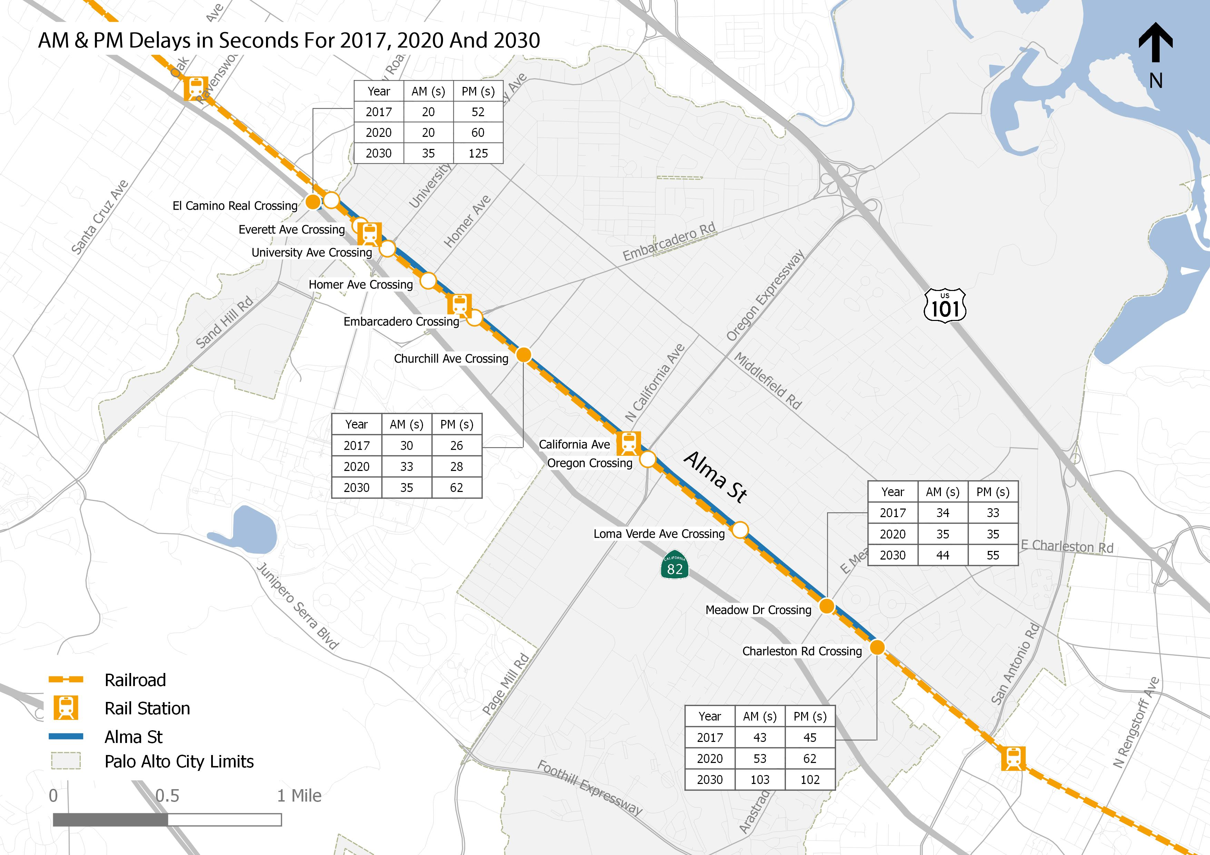
AM & PM Delays in Seconds for 2017, 2020, 2030
Average delay per vehicle crossing Caltrain tracks
Caltrain operating at planned levels
HSR Operating as planned
No changes to Existing Crossings
Notes:
This is an “overall” average delay condition with gate closures as prescribed.

Slide 13
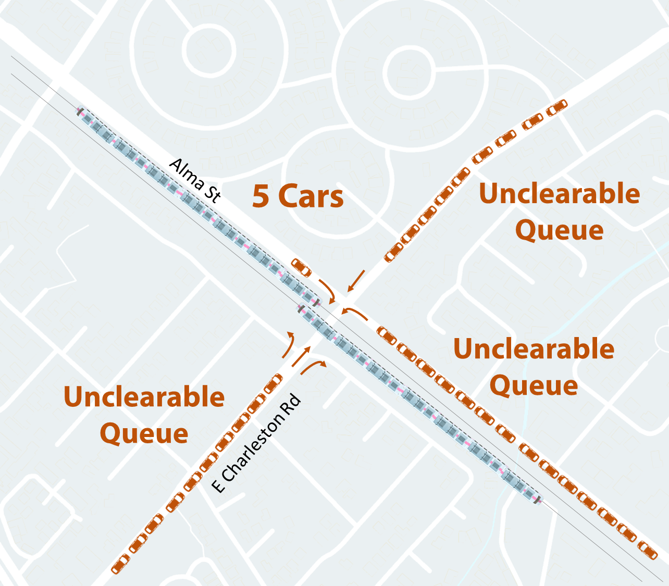
2030 Charleston Rd PM Peak Queues (20 Trains/hr)
Notes:
Just 1 sample – the rest are similar.

Slide 14
Traffic Conditions for “No Build” Scenarios
Overall Level-of-Service of Key Rail Crossing Movements
Crossing | 2017 | 2020 | 2030
Palo Alto Ave | E/F | F | F
Churchill Ave | E | F | F
Meadow Dr | D/E | D/E | E/F
Charleston Rd | E/F | F | F
Notes:
Overall average delay condition.

Slide 15
Testing the 6 Sample Scenarios at 2030:
TRAFFIC EFFECTS

Slide 16
Rail Corridor Circulation Study: Traffic Measures
Crossing | Existing (No Build) | Sample Scenario
 |  | 1 | 2 | 3 | 4 | 5 | 6
 |  | Low Build | Low-Medium Build | Medium Build | Full Build Phase 1 | Full Build Option A | Full Build Option B
Palo Alto Ave (AKA Alma St) | A | X | X | A | A | Q | S
University Ave | S | S | S | S | S | S | S
Embarcadero Rd | S | W | S | W | S | S | W
Churchill Ave | A | X | Q | A | A | A | A
Oregon Expwy | S | S | S | S | S | S | S
E/W Meadow Dr | A | X | X | A | A | S | S
E/W Charleston Rd | A | S | S | S | S | S | S
Key EXISTING
NEW
A = At Grade Q = Quiet Zone W = Widened Grade Separated X = Closed to all Traffic S = Grade Separated
Notes:
Provides a good synopsis of most likely conditions for alternatives.

Slide 17
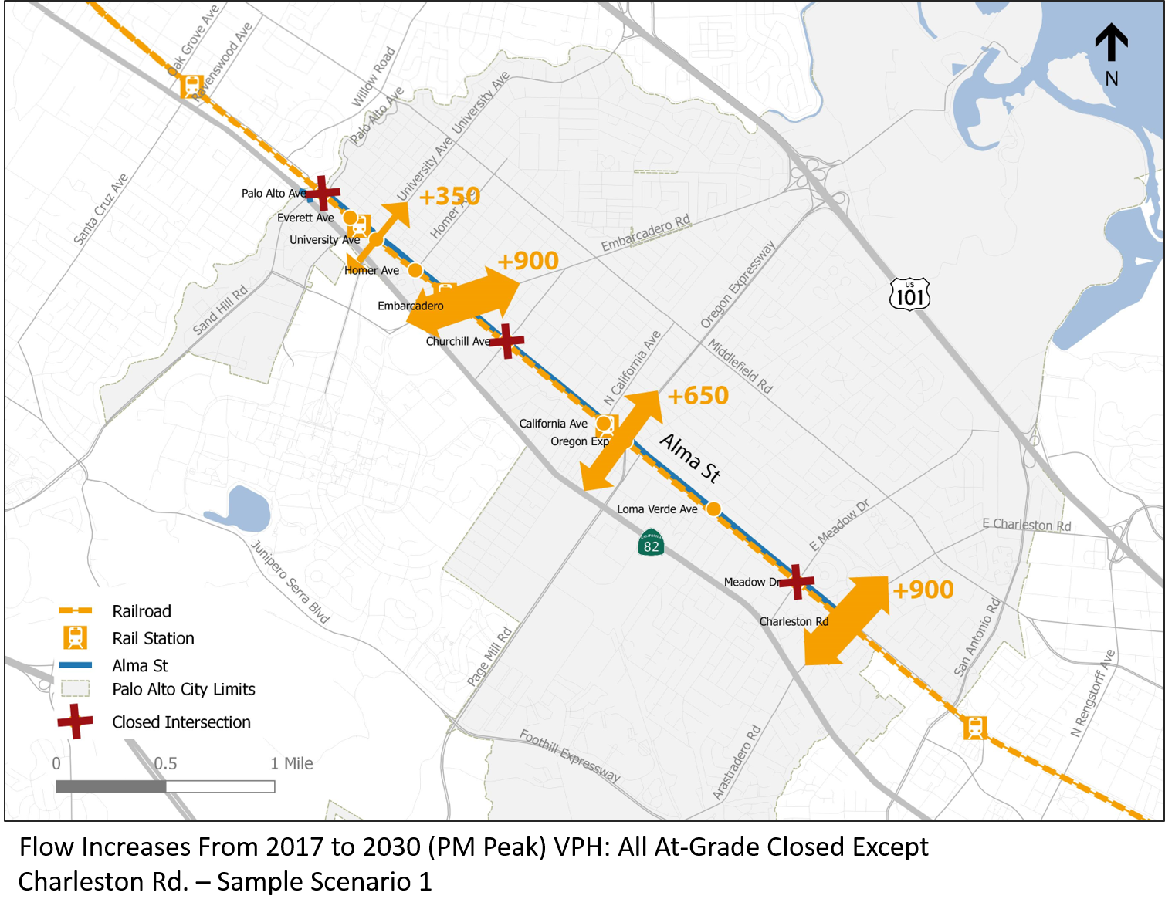
Scenario 1: CAPACITY CONSTRAINED TEST
Notes:
Reminder: This is 2030 Reassigned Flows against Existing (2017).

Slide 18
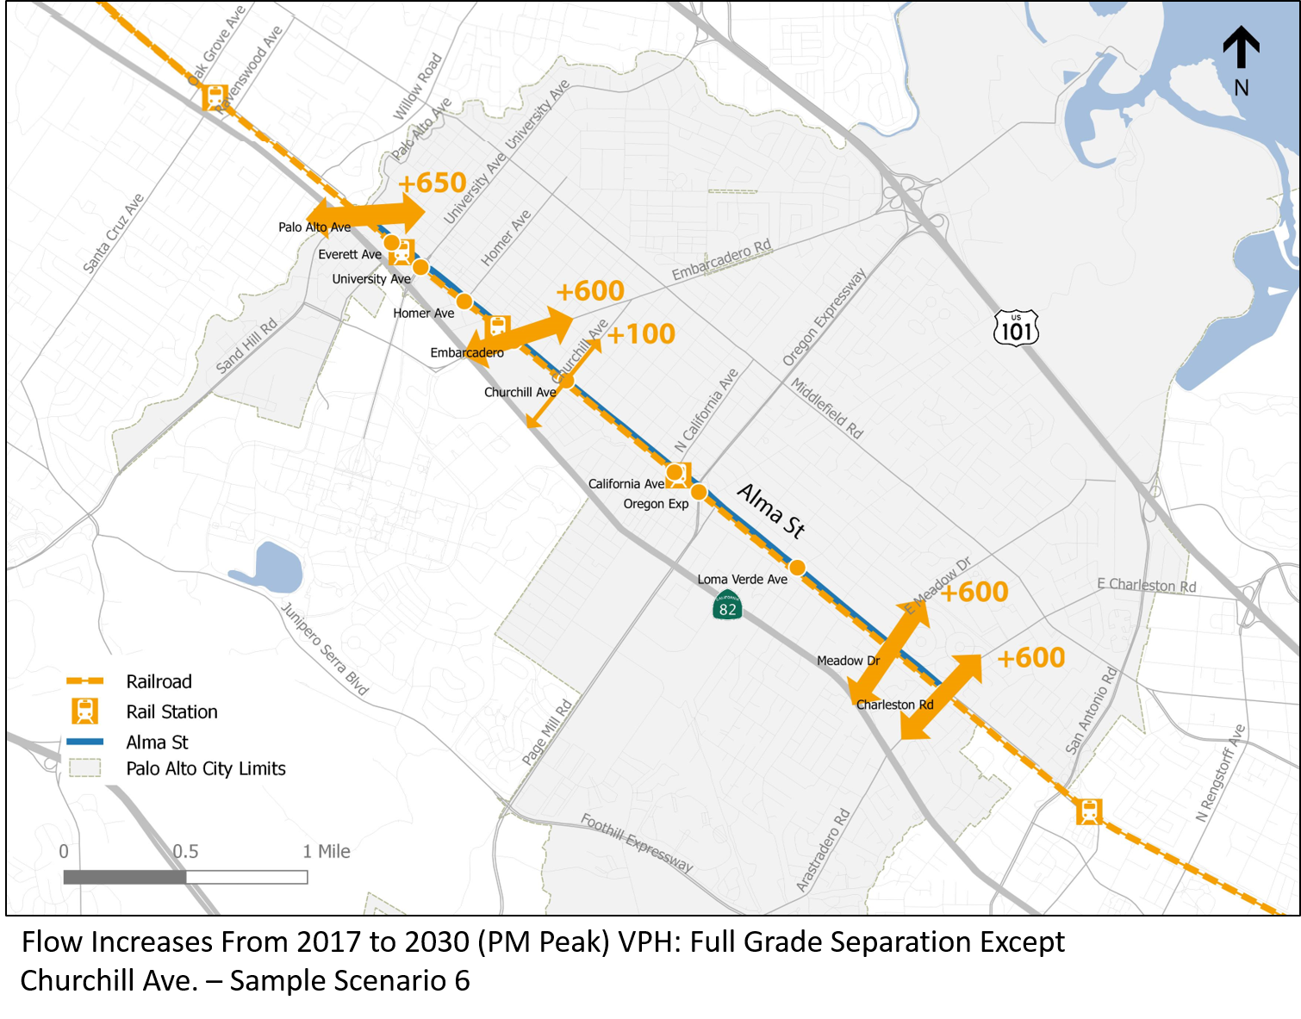
Scenario 6: MAXIMUM ACCESSIBILITY TEST
Notes:
Reminder: This is Reassignment at 2030 from No-Build to Scenario 1.

Slide 19
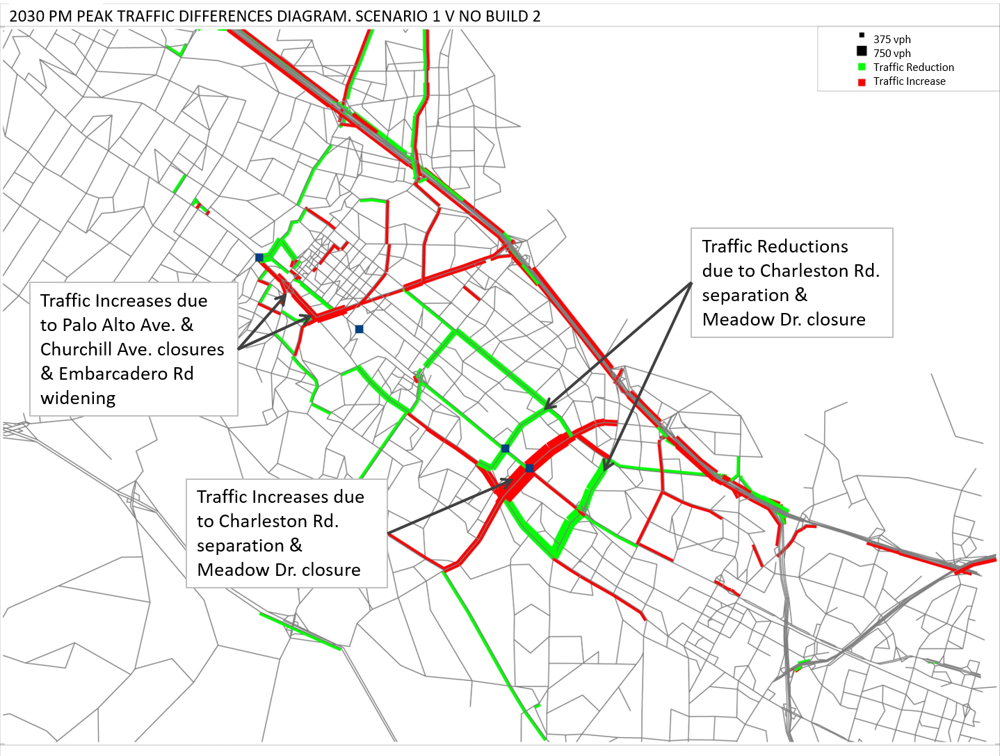
REROUTING IMPACTS: Scenario 1
Notes:
These are differences at 2030 between No-Build 2 and Scenario 1. This is not the same as the two previous slides.

Slide 20
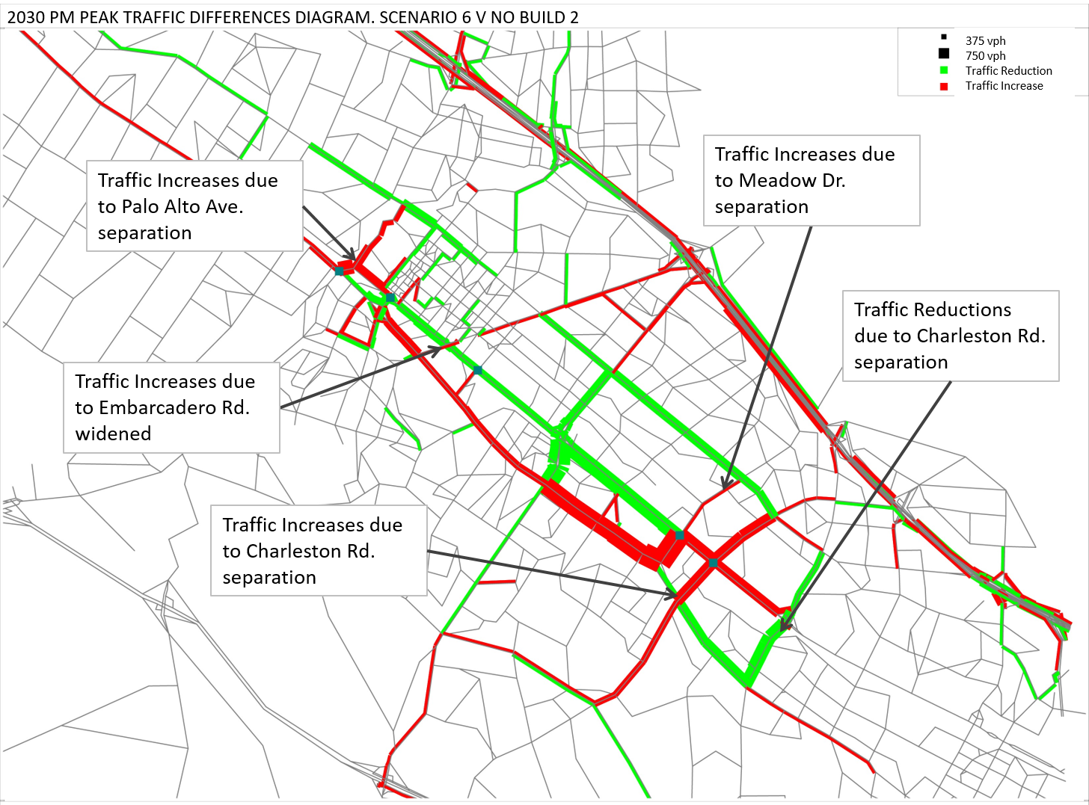
REROUTING IMPACTS: Scenario 6

Slide 21
Summary of Response of the At-Grade Intersections to Change
 | Remain at-grade | Closed | Grade-separated
Palo Alto Ave / Alma St | Little effect | Sheds small amount of traffic to Ravenswood Ave and University Ave | Significantly increases traffic flows. (~30%)
Churchill Ave | Little effect | Considerable diversion to Embarcadero Rd, which if widened could operate satisfactorily. | It is suspected that there would be little effect on other grade crossings, if other separations implemented. Could attract small amounts of traffic.
E/W Meadow Drive | As traffic grows, will shed to Oregon Expressway and Charleston Rd (if grade separated) | Some diversion to Charleston Road; significant if Charleston is grade-separated | Significantly increases traffic flows (~50%)
Charleston Rd | As traffic grows, will shed to San Antonio Road | Not tested but likely to either shed significant traffic to San Antonio Road or reduce traffic overall | Significant increases to traffic flows (50+%). Some diverts from San Antonio Rd.
Condition
Location
Notes:
Redistribution of crossing traffic under Scenario 6 improves operational conditions for crossings. But also increases congestion on newly grade-separated routes.

Slide 22
Testing the 6 Sample Scenarios at 2030:
BICYCLE & PEDESTRIAN EFFECTS

Slide 23
Rail Corridor Circulation Study: Bicycle and Pedestrian Measures for the Sample Scenarios 1-6
BICYCLES & PEDESTRIANS
Crossing | Existing (No Build) | Sample Scenario
 |  | 1 | 2 | 3 | 4 | 5 | 6
 |  | Low Build | Low-Medium Build | Medium Build | Full Build Phase 1 | Full Build Option A | Full Build Option B
Everett Ave/Lytton Ave | - | - | B/P | - | - | - | B/P
Homer Ave | B/P | B/P | B/P | B/P | B/P | B/P | B/P
Churchill Ave ¹ |  | - | - | B/P | - | B/P | -
California Ave | B/P | B/P | B/P | B/P | B/P | B/P | B/P
Loma Verde Ave/ Matadero Creek | - | - | B/P | - | B/P | B/P | B/P
E/W Meadow Dr. ¹ |  | - | - | B/P | - | - | -
Key EXISTING
NEW
B/P = Grade-Separated Bicycle/Pedestrian Only ¹ = In close proximity

Slide 24
Notes:
Pedestrians would be the same as bikes but different journey times. (5 minute bike = 25 minute ped.)

Slide 25
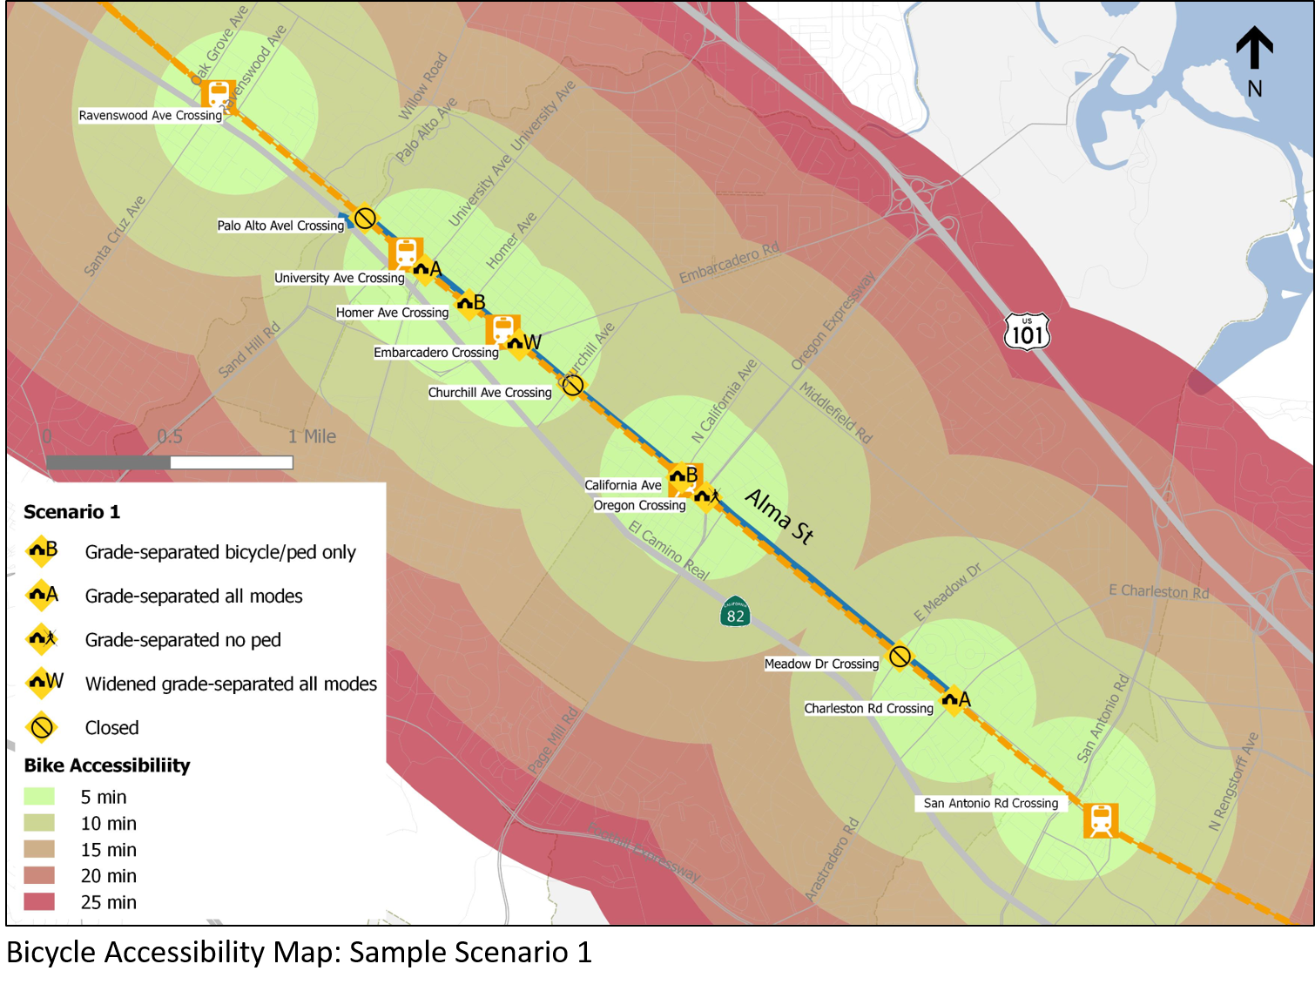

Slide 26
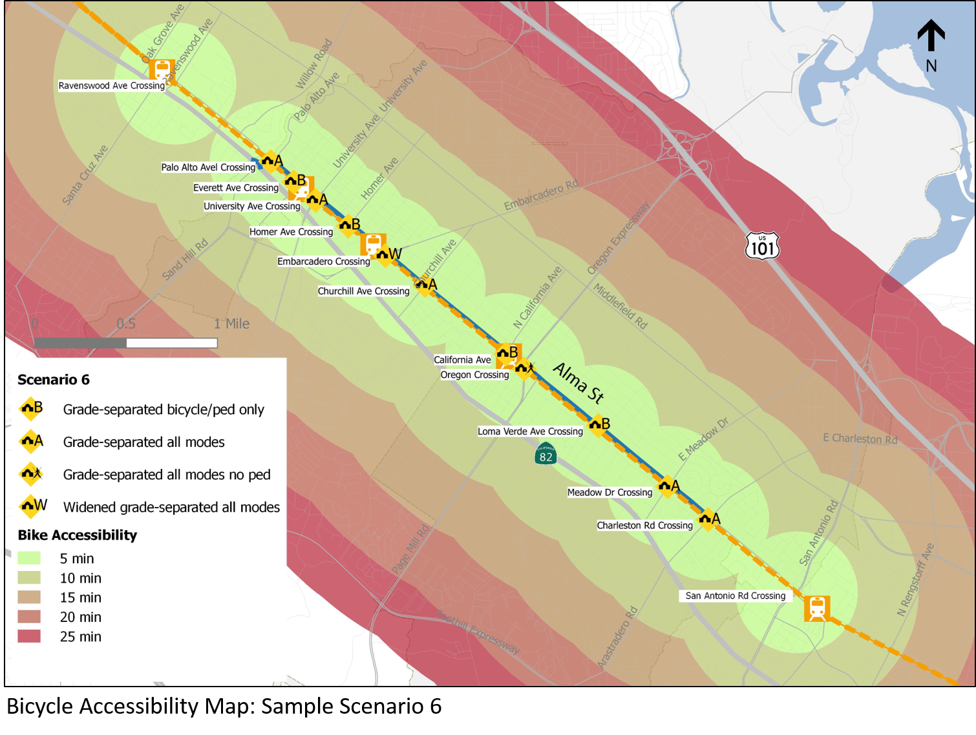

Slide 27
Study Area Intersection Roadway Collision Data 2011-2015
 | Alma St & Palo Alto Ave | Alma St & Churchill Ave | Alma St & Meadow Dr | Alma St & Charleston Rd
Total Collisions | 6 | 30 | 25 | 27
Injury Collisions | 1 | 10 | 11 | 10
Fatal Collisions | 0 | 0 | 0 | 1
Location
Item
Source: SWITRS data provided by City of Palo Alto, 2017
Notes:
Not possible to estimate reduction until layout designs are identified, but will always be better as latest design / safety standards would be implemented.

Slide 28
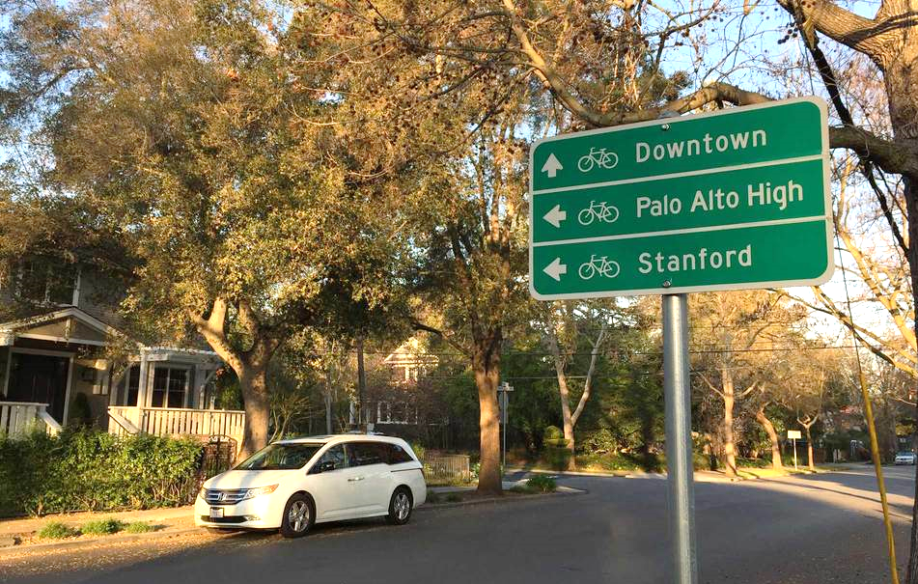
Report No. 1 of the Rail Corridor Circulation Studies
Josh Mello
Chief Transportation Official

Slide 29
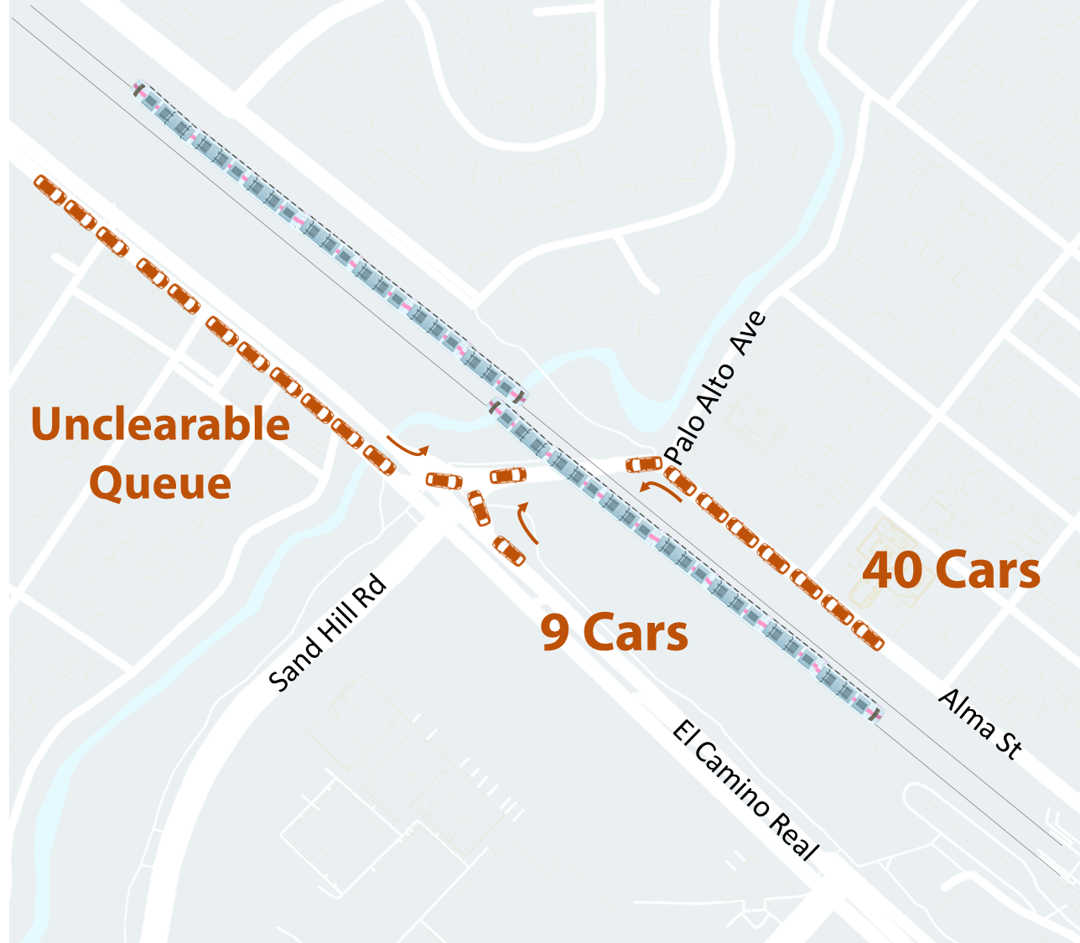
2030 Palo Alto Ave PM Peak Queues (20 Trains/hr)

Slide 30
2030 Palo Alto Ave PM Peak Queues (20 Trains/hr)

Slide 31
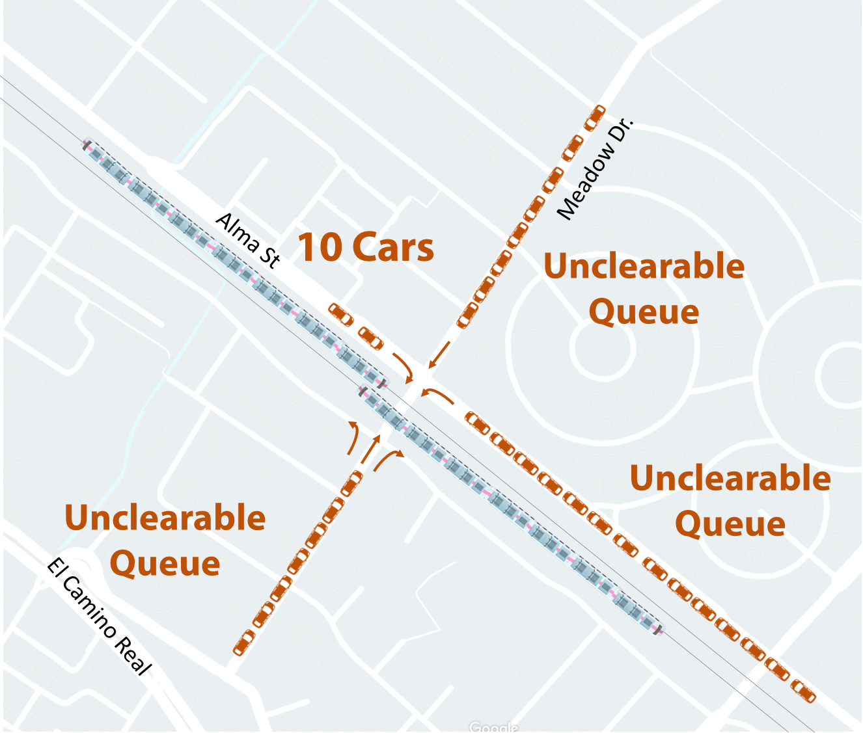
2030 Meadow Dr. PM Peak Queues (20 Trains/hr)

Slide 32
Notes:
Traffic volume = Green
Train Frequency = Blue
Queues = Red
Maximum Queues only occur when all 3 peak together and only for a short time. To model that would be unrepresentative of conditions for whole peak period and would vary by location and direction.
Source: Caltrain Grade Crossing Hazard Analysis and Report, February 2016.

Slide 33
Notes:
Traffic volume = Green
Train Frequency = Blue
Queues = Red
Maximum Queues only occur when all 3 peak together and only for a short time. To model that would be unrepresentative of conditions for whole peak period and would vary by location and direction.
Source: Caltrain Grade Crossing Hazard Analysis and Report, February 2016.

